Slide 1
Wrapping Up The UnWrapping Pastor Mark Schwarzbauer PhD Family Worship Center

Slide 2
I Corinthians 14:15
“What is the conclusion then? I will pray with the spirit, and I will also pray with the understanding. I will sing with the spirit, and I will also sing with the understanding.”

Slide 3
Part One: The Review

Slide 4
Hebrews 6:1-3
“Therefore, leaving the discussion of the elementary principles of Christ, let us go on to perfection, not laying again the foundation of repentance from dead works and of faith toward God, ² of the doctrine of baptisms, of laying on of hands, of resurrection of the dead, and of eternal judgment. ³ And this we will do if God permits.”

Slide 5
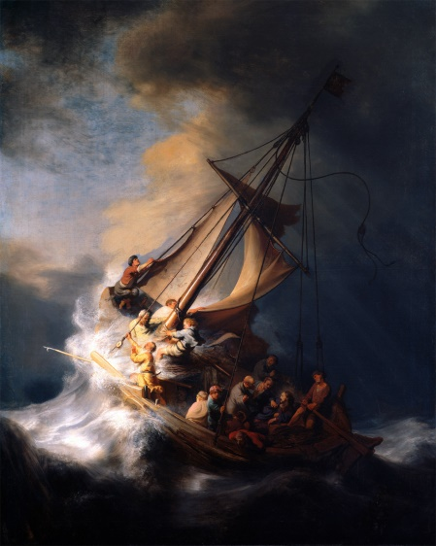
Pastor Mark Schwarzbauer PhD Family Worship Center
Foundation of Repentance
The Lost Art of
Repentance

Slide 6
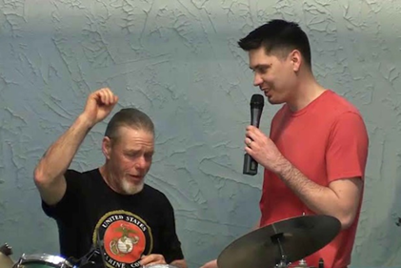
Why Does God Want You to Get Baptized? Pastor Mark Schwarzbauer PhD Family Worship Center

Slide 7
Myths & Marvels Pastor Mark Schwarzbauer PhD Family Worship Center

Slide 9
The Beauty of
Spiritual Language
Pastor Mark Schwarzbauer PhD
Family Worship Center

Slide 10
i-fwc.com/Media/archive.html

Slide 11
Part Two: The Resource

Slide 12
At the Assemblies of God General Council last year, Jack Hayford shared “While affirming speaking in tongues as the initial physical evidence of the baptism in the Holy Spirit, Hayford cautioned attendees against viewing the gift solely in evidentiary terms. "God did not give it as a proof," Hayford said. "He gave it as a resource." Hayford said experiencing the Holy Spirit is essential for a church body to grow. http://www.charismanews.com/world/51086-pastor-jack-hayford-christians-should-not-expect-to-escape-the-coming-persecution

Slide 13
The Gift of Spiritual Language – Tongues are…
ONE - The initial physical evidence of the Baptism in the Holy Spirit – Acts 2, 10, 19 et al (for the extensive Scriptural support please see Pentecost 101 and 102).
TWO - A spiritual language for personal prayer, Romans 8:26, I Cor. 14, Ephesians 6:18, Jude 20.

Slide 14
The Gift of Spiritual Language – Tongues are…
THREE - A spiritual language for worship, Acts 2:11, I Cor. 14:15.
FOUR - A gift used to speak a message in church, to be accompanied by interpretation, to edify the church, deliver a message from God and to remind us not to harden our hearts. I Cor. 14, Isaiah 28:11,12.

Slide 15
Part Three: The Reminder

Slide 16
Part Three: The Reminder to Be Sensitive to the Holy Spirit

Slide 17
You are involved in being sensitive to the Holy Spirit… “In Acts 2:4 which is the first time anyone ever actually spoke with tongues, this key text assists us in understanding the link between the miracle of the language and the mind-set to speak in response. “And they were all filled with the Holy Spirit and began to speak with other tongues, as the Spirit gave them utterance.”

Slide 18
The verb “they began” is pointing in its timing – aorist being the Greek tense. The grammatical form makes the statement clear – “At this point, they (the people being filled) began (as a participative response) to speak with tongues.” The linguistic miracle is shown in the verb in the phrase “as the Spirit gave.” The Spirit was continuously giving then what they were speaking out loud.”

Slide 19
It is also a striking fact that the verb apophthegomai (“utterance”) is used; a word in coming Greek usage which not only described outspoken declarative speech, but which was used for speech thought to be motivated by a divine, prophetic impulse.

Slide 20
So Paul’s explanation that Holy-Spirit-inspired speech is still only spoken by the speaker’s choice, and the fact that that’s the way Pentecost was, both released me to decide: I will speak! It wasn’t a presumption born of enthusiasm, but an obedience born of faith.” Page 48-49 The Beauty of Spiritual Language, Jack Hayford.

Slide 21
The early church was very sensitive to the Holy Spirit…
Acts 7:51 “You always resist the Holy Spirit.”
Acts 11:28 “The Spirit told me to go with them.”
Acts 11:28 “One of them… showed by the Spirit that there was going to be a great famine…”
Acts 13:4 “Being sent out by the Holy Spirit.”

Slide 22
The early church was very sensitive to the Holy Spirit…
Acts 15:28 “For it seemed good to the Holy Spirit, and to us…”
Acts 18:5 “Paul was compelled by the Spirit and testified…”
Acts 19:21 “Paul felt compelled by the Spirit to go over to Macedonia.”

Slide 23
Be Sensitive to the Conviction of the Holy Spirit…
John 16:8 “And when He has come, He will convict the world of sin, and of righteousness, and of judgment:”

Slide 24
Be Sensitive to the Confort of the Holy Spirit…
John 14:16-17 “¹⁶ And I will pray the Father, and He will give you another Helper, that He may abide with you forever— ¹⁷ the Spirit of truth, whom the world cannot receive, because it neither sees Him nor knows Him; but you know Him, for He dwells with you and will be in you.”

Slide 25
Be Sensitive to the Guidance of the Holy Spirit…
To experience the
guidance of the Holy Spirit
we need to first be
sensitive to the conviction
and after confession
accept His comfort.

