Slide 1
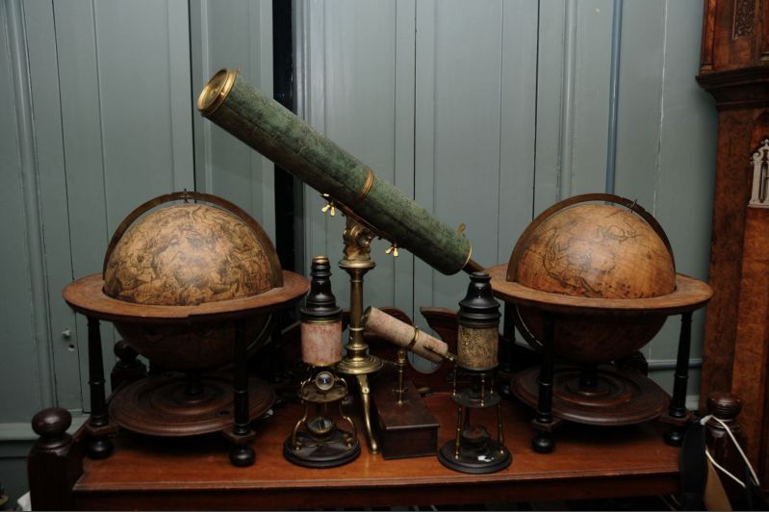
Why I Am Not an Atheist
Part Four: Worldview
Family Worship Center
Pastor Mark
Schwarzbauer, Ph.D.

Slide 2
Colossians 2:8-10
⁸Beware lest anyone cheat you through philosophy and empty deceit, according to the tradition of men, according to the basic principles of the world, and not according to Christ. ⁹For in Him dwells all the fullness of the Godhead bodily; ¹⁰and you are complete in Him, who is the head of all principality and power.

Slide 3
Part One:
Your
Worldview

Slide 4
Worldview defined… “Everyone has a worldview. Whether or not we realize it, we all have certain presuppositions and biases that affect the way we view all of life and reality. A worldview is like a set of lenses which taint our vision or alter the way we perceive the world around us. Our worldview is formed by our education, our upbringing, the culture we live in, the books we read, the media and movies we absorb, etc. For many people their worldview is simply something they have absorbed by osmosis from their surrounding cultural influences.” ~ http://christianworldview.net/ index page on 8/14/13

Slide 5
3 Prevalent Worldviews.
1. Atheistic Worldview of Materialism or Naturalism… “Naturalism is a worldview, a philosophy -- a general understanding of reality and humanity's place within reality. Naturalism is usually defined most briefly as the philosophical conclusion that the only reality is nature, as gradually discovered by our intelligence using the tools of experience, reason, and science.” http://www.naturalisms.org/ index page on 8/14/13

Slide 6
3 Prevalent Worldviews.
2. Humanistic/Hedonism…Humans are the center of life, the meaning of life is personal pleasure; God and the rest are irrelevant. Description by Dr. Mark Schwarzbauer

Slide 7
3 Prevalent Worldviews.
2. Humanistic/Hedonism…Humans are the center of life, the meaning of life is personal pleasure; God and the rest are irrelevant. Description by Dr. Mark Schwarzbauer
3. Christianity… “There is a creator God revealed in the Holy Bible who loves us & through Jesus restores us in relationship to Himself.” Definition by Dr. Mark Schwarzbauer

Slide 8
3 Common Worldviews Mark Schwarzbauer PhD ©2013 | Pre-suppositions | View of God | View of Man | Ultimate Consequences To Humanity | Consequence to Science
Atheistic Materialism | Postures itself as neutral observers who hold rational views based solely on evidence. However, it starts with and is controlled by the presuppositions that there is no God and only material is real. Admittedly, these are not scientific but “philosophical conclusions.” www.naturalisms.org | God does not exist There is no life after death. | Man is only a small part of the natural realm as an evolved animal. Significance is self-infused. Free will is an illusion. | As Nietzsche predicted~ Atheistic Regimes of Hitler, Stalin & Mao kill 140 million – more in 1 century than all religions in all of history combined. | Evolution is only remaining choice; requires Time & Matter & Chance. Requires billions of years so it creates further presuppositions that the universe is very old and chance can create positive mutations leading to new and complex designs. Everything is looked at from these presuppositions.

Slide 9
3 Common Worldviews Mark Schwarzbauer PhD ©2013 | Pre-suppositions | View of God | View of Man | Ultimate Consequences To Humanity | Consequence to Science
Humanistic Hedonism | Humans are the center of life. Pleasure is good. Pain is bad. Living for the moment – Existential. | God is irrelevant. Thinking about eternity only brings frustrat-ion (pain) so one should only focus on the present moment. | Each person is the center of his/her universe. | Everyone does what feels good for him/herself ~ Self-centered leads to Selfishness. Although purporting to value man it ultimately undermines him. | Rejects what is dehumanizing. Science is valuable when adding pleasure and value to humanity.

Slide 10
3 Common Worldviews Mark Schwarzbauer PhD ©2013 | Pre-suppositions | View of God | View of Man | Ultimate Consequences To Humanity | Consequence to Science
Christianity | There is a creator God. God reveals Himself in the Holy Bible. | The Triune God loves the world so much He gives His son to redeem man. | Man is a special creation in the image of God. Though man is fallen in nature, God seeks to redeem man. | As a special creation man is of utmost worth. Christians build churches to share redemption, hospitals to heal, orphanages to care. Called to love fellow man as second greatest commandment. | Science and faith are not antithetical. God created the universe so doing scientific study is to admire the work of God. Majority of the greatest scientists have been Christians and modern science grew from Christian influence. Since God created the universe, there is no presupposition that the universe is old.

Slide 11
The Effects of Worldviews
A. “People always interpret evidence in a way that is compatible with their worldview. Thus, evidence by itself will never settle the debate.” Jason Lisle pg28
B. DNA, rock formations, fossils et al are used by both sides of argument of creation vs. evolution.
C. The bottom line is not evidence, but interpretation controlled by worldviews.

Slide 12
Part Two:
Your
Philosophy of Life

Slide 13

C.S. Lewis stated…
“We all have a philosophy of life. The only question is whether it is a good one or a bad one.”

Slide 14
Colossians 2:8-10
⁸Beware lest anyone cheat you through philosophy and empty deceit, according to the tradition of men, according to the basic principles of the world, and not according to Christ. ⁹For in Him dwells all the fullness of the Godhead bodily; ¹⁰and you are complete in Him, who is the head of all principality and power.

Slide 15
Beware- be on the lookout!
(NIV “see to it”).

Slide 16
Beware- be on the lookout!
(NIV “see to it”).
America is becoming doused with new atheism and old hedonism.

Slide 17
“Cheated through philosophy and empty deceit.”
Cheated comes from the Greek word sulagwgw' (sulagogon).
Meaning- To carry off as spoil.

Slide 18
“Cheated through philosophy and empty deceit.”
According to the tradition of men… new atheists.
According to basic principles of the world… hedonistic pleasure seekers.

Slide 19

Philosophy
From the Greek word filosofiva philosophia.
Denotes a supposed love and pursuit of wisdom, hence, philosophy is the investigation of nature and truth.

Slide 20
Philosophy
Josephus speaks of the three Jewish sects as three “philosophies”.
To the Greeks denoted the highest effort of the intellect.

Slide 21
Philosophy
However, it ONLY OCCURS HERE in Paul’s writings.
The Gospel had deposed the term.
What philosophy had become was seen as inadequate and flawed.

Slide 22
Philosophy vs. Gospel
Philosophy~ Man’s pursuit of God or no-God and understanding life.
Gospel~ God’s pursuit of man and revelation of truth.

Slide 23
Philosophy
Knowing Philosophy for the sake of witness- Paul in Athens used his knowledge of philosophy to win powerful and influential people to Christ.

Slide 24
The Revelation of God
How can you know anything? Epistemology.
2. The Bible is God’s revelation and must be the Authority.

Slide 25
The Revelation of God
3. The main reason atheists and some unbelieving scholars reject the Bible is not on the basis of the evidence, but on the basis of anti-supernaturalism. A second reason, and perhaps the underlying motive, is resistance to accountability.

Slide 26
Reason Number 7 that I am not an atheist ~Atheists admit that their materialistic worldview control presuppositions are purely philosophical; but duplicitously couch their belief system as being purely scientific. They further cast a false war between Christianity and Science. Because I reject these mendacious misrepresentations I cannot be an atheist. I instead choose the Christian worldview cognizant of it presuppositions and appreciative of its logical and natural consequences.

Slide 27
Christ all the fullness
You are complete in Him.
You don’t need more God in your life… you need more surrender to God in your life.

