Slide 1
Why I am not an atheist Part two Logical consistency and morality Pastor Mark Schwarzbauer PhD Family Worship Center

Slide 2
Romans 1:18-20
18 For the wrath of God is revealed from heaven against all ungodliness and unrighteousness of men, who suppress the truth in unrighteousness, 19 because what may be known of God is manifest in them, for God has shown it to them.

Slide 3
Romans 1:18-20
20 For since the creation of the world His invisible attributes are clearly seen, being understood by the things that are made, even His eternal power and Godhead, so that they are without excuse,”

Slide 4
Part One: To believe or not to believe… that is the question.

Slide 5
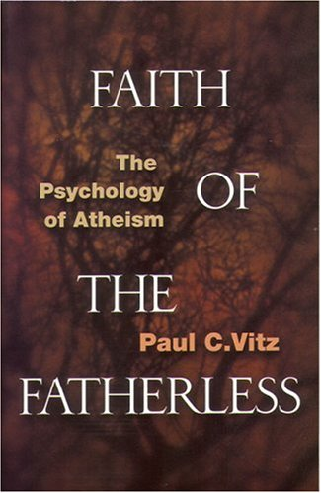
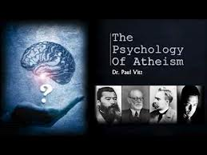
PAUL C. VITZ, a professor of psychology at New York University, was an atheist until his late 30s. He earned his bachelor's degree at the University of Michigan and his Ph.D. at Stanford.
Search:
youtube paul vitz

Slide 6
Part Two: Why I am not an atheist

Slide 7
Part Three: Why I am not an atheist

Slide 8
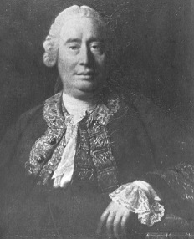
David Hume
David Hume – “The most important philosopher ever to write in English, David Hume (1711-1776) — the last of the great triumvirate of “British empiricists”
http://plato.stanford.edu/entries/hume/

Slide 9
David Hume
Charles Darwin counted Hume as a central influence, as did “Darwin's bulldog,” Thomas Henry Huxley.”
http://plato.stanford.edu/entries/hume/

Slide 10
David Hume
“In light of these considerations, we may conclude that with respect to thick theism Hume is a hard skeptic who defends a non-dogmatic form of atheism.”
http://plato.stanford.edu/entries/hume-religion/#10

Slide 11
David Hume
“If we take in our hand any volume: of divinity or school of metaphysics, for instance; let us ask, does it contain any abstract reasoning concerning quantity of number? No. Does it contain any experimental reasoning concerning matter of fact and existence? No. Commit it then to the flames; For it can contain nothing but sophistry and illusion.”

Slide 12
David Hume
His statement contains no mathematical (quantity of number) or scientific basis (experimental reasoning concerning matter of fact and existence) and therefore his own test fails his own test and according to his own statement what he says “contains nothing but sophistry and illusion” and should be burned!

Slide 13
Why I am not an atheist
Logical inconsistency of those believing there is no such thing as a being of all knowledge presupposes having
all knowledge.

Slide 14
Why I am not an atheist
C. Failure of proof from atheists demanding proof.
D. They point out seeming contradictions in the Bible… but contextual study obliterates their claims as logically inconsistent.
E. William Lane Craig and Christopher Hitchens example (see link).

Slide 15
Learning to be the light or ~ The Voice Of Culture Pastor Mark Schwarzbauer PhD Family Worship Center

Slide 16
Why I am not an atheist
“Russell admitted that he could not live as though ethical values were simply a matter of personal taste, and that he therefore found his own views “incredible.” “I do not know the solution,” he confessed. “ The point is that if there is no God, then objective right and wrong cannot exist.”

Slide 17
Why I am not an atheist
Dostoyevsky said if there is no God
“All things are permitted.”

Slide 18
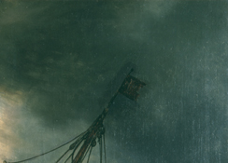
Nietzsche said: "When one gives up the Christian faith, one pulls the right to Christian morality from under one's feet. This morality is by no means self-evident. Christianity is a system, a whole view of things thought out together. By breaking one main concept out of it, the faith in God, one breaks the whole. It stands or falls with faith in God.” (ie If there is no God there is no morality).

Slide 19
Why I am not an atheist
True motives – Aldous Huxley – “For myself, as, no doubt, for most of my contemporaries, the philosophy of meaninglessness was essentially an instrument of liberation. The liberation we desired was simultaneously liberation from a certain political and economic system and liberation from a certain system of morality. We objected to the morality because it interfered with our sexual freedom;” Aldous Huxley, Ends and Means: An Inquiry into the Nature of Ideals and into the Methods Employed for Their Realization (New York: Harper & Bros., 1937), 316.

Slide 20
Why I am not an atheist
Often repeated atheist argument…
“With all the evil in the world, how can there be a God?”

Slide 21
Forward logic…
In order to say there is evil one must also believe in good.
In order to differentiate between good and evil there must be a supreme moral law.
The existence of a moral law assumes the existence of a supreme moral lawgiver- God!

Slide 22
Reverse Logic…
If there is no God- there is no supreme moral lawgiver.
If there is no moral lawgiver there can be no supreme moral law and therefore no way to differentiate between good and evil.
If you cannot differentiate between good and evil you cannot say evil exists to negate the existence of God.

Slide 23
Why I am not an atheist
New Atheists are now going against the teachings of Nietzsche, Huxley and others and say “We don’t need God to be good” and profess an “objective moral law.”

Slide 24
Why I am not an atheist
The reason for their change is that they were obliterated in debates by simple moral questions like is it acceptable to torture babies for fun or treat a person as sub-human because of the color of their skin?

Slide 25
Why I am not an atheist
Craig Hazen replies… “The primary technique the new atheists have adopted for dealing with the issue of the origin or grounding of the moral law is obfuscation. The new atheists are very fond of saying, “We don’t need God to be good.” Indeed, they often say that atheists, agnostics and skeptics often lead more wholesome lives than lifelong professing Christians.

Slide 26
Why I am not an atheist
Now, theists should not be fooled by this. Our response should be, “Of course you don’t need God to be good — we’ve never claimed that you do.” You see, it is not knowledge (epistemology) of the moral law that is a problem — after all, the Bible teaches that this law is written on every human heart. Rather, the daunting problem for the new atheist is the nature and source (ontology) of the moral law.”

Slide 27
Why I am not an atheist
Where did the moral law come from if there is no moral law giver?
If everything ultimately must be explained by the laws of physics and chemistry, help me understand what a moral value is (does it have mass, occupy space, hold a charge, have wavelength)?

Slide 28
Why I am not an atheist
How did matter, energy, time and chance result in a set of objective moral values? Did the big bang really spew forth “love your enemy?” If so, you have to help me understand that.
Watch them obfuscate and quickly deflect the argument as they can’t answer it in a logically consistent or rational manner.

Slide 29
Additional Reasons Why I am not an atheist
4. The logical inconsistencies prevalent in atheism are glaring; such as Hume’s statement which fails its own tests, and to declare you have all knowledge that there is no being of all knowledge. Because I insist on logical consistency I cannot be an atheist.

Slide 30
Additional Reasons Why I am not an atheist
5. Classic atheists denied objective Moral Law because they knew it logically leads to a Moral Law Giver. The new atheists after losing this point in debates now claim there is objective moral law but can’t answer where it comes from. Because I believe in objective moral law and honest logical consistency I cannot be an atheist.

Slide 31
Romans 1:18-20
18 For the wrath of God is revealed from heaven against all ungodliness and unrighteousness of men, who suppress the truth in unrighteousness, 19 because what may be known of God is manifest in them, for God has shown it to them.

Slide 32
Romans 1:18-20
20 For since the creation of the world His invisible attributes are clearly seen, being understood by the things that are made, even His eternal power and Godhead, so that they are without excuse,”

Slide 33
Why I am not an atheist- Romans 1:18-20
1. The wrath of God is not against the men themselves, but against their unrighteousness and suppression of truth.
2. Their very claim to objective moral law is evidence of God… because what may be known of God is manifest in them, for God has shown it to them.

Slide 34
Romans 1:18-20
20 For since the creation of the world His invisible attributes are clearly seen, being understood by the things that are made, even His eternal power and Godhead, so that they are without excuse,”

Slide 35
Romans 1:18-20
20 For since the creation of the world His invisible attributes are clearly seen,
being understood by the things that are made, even His eternal power and Godhead, so that they are without excuse,”
The Invisible is clearly seen
when we look at it without psychological distortions
and deficiencies.

