Slide 1
Why I am not an atheist
Part One
Pastor Mark Schwarzbauer PhD
Family Worship Center

Slide 2

Romans 1:20
For the invisible things of him from the creation of the world are clearly seen, being understood by the things that are made, even his eternal power and Godhead; so that they are without excuse.

Slide 3
Part One:
To believe or not to believe… that is the question.

Slide 4
To believe or not to believe…
From the moment of birth, everyone is trying to make sense of the world.
Who is important and how do I get my needs met?
Once physical and psychological needs are met we move from self-centered questions to those of meaning.

Slide 5
Questions of Meaning
Why am I here? (The Meaning of Life).
Where did all this come from? (The Origen of Life).
What happens after I die? (The Question of Eternity).
What is real? (The Question of Coherency).

Slide 6
To believe or not to believe…
Some people fail to move beyond psychological needs and build their belief system to meet them.

Slide 7
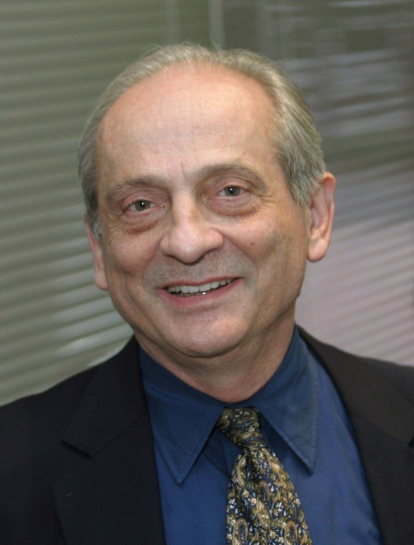
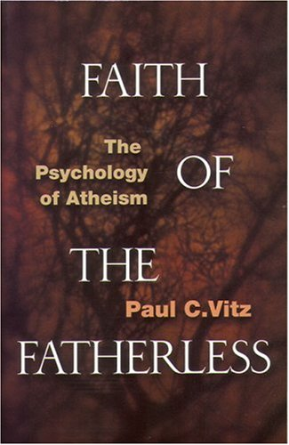
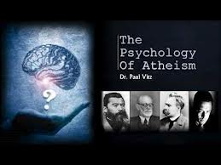
PAUL C. VITZ, a professor of psychology at New York University, was an atheist until his late 30s. He earned his bachelor's degree at the University of Michigan and his Ph.D. at Stanford.
Search:
youtube paul vitz

Slide 8
“Vitz’s study challenges the widespread assumption throughout much of the intellectual community that belief in God is based on irrational, immature needs and wishful thinking, whereas skepticism is derived from a rational, no-nonsense appraisal of the way things really are. Since psychology is a weapon that skeptics have chosen to wield against God, it is not unfair for us to ask the same questions of them.”
Beyond Opinion by Ravi Zacharias, c2007 Thomas Nelson Publishers.

Slide 9
Vitz says “In summary because of my social needs to assimilate, because of my professional needs to be accepted as an academic psychologist, and because of my personal need for a convenient lifestyle; for all of these needs atheism was simply the best policy… I think these reasons may be the most common by far.”
The Psychology of Atheists – Available on Youtube – search youtube Paul Vitz

Slide 10
To believe or not to believe…
Professor Vitz goes on to examine deeper psychological needs that predispose atheists.

Slide 11
“The single most important social influence on the spiritual live of teens is their parents. Fathers in particular have a vital role to play in the spiritual development of their children. In his fascinating books “Faith of the Fatherless” social scientist Paul Vitz writes that in his study of the world’s most influential atheists (including Friedrich Nietzsche, David Hume, Bertrand Russell, John Paul Sartre, Albert Camus and H. G. Wells), all had one thing in common: defective relationships with their fathers.”

Slide 12
“Moreover, when Vitz studied the lives of influential theists (such as Blaise Pascal, Edmund Burke, Moses Mendelssohn, Soren Kierkegaard, G.K. Chesterton, and Dietrich Bonhoeffer) during those same historical time periods, he found they enjoyed a strong, loving relationship with a father figure.”
Beyond Opinion by Ravi Zacharias, c2007 Thomas Nelson Publishers.

Slide 13

Father to the
Fatherless
Pastor Mark Schwarzbauer PhD
Family Worship Center

Slide 14
To believe or not to believe…
The sarcastic vitriol of the new atheist’s leaders like Dawkins, Hitchens and Harris, forces me to question why are they acting like Junior High School bullies? I’m a behavioral scientist and their mean spirited attacks tell me much more than their supposedly arguments. When someone has to use their level of vitriol and intimidation it suggests inherent weakness in their arguments. – Dr Mark Schwarzbauer.

Slide 15
To believe or not to believe…
In the end everyone must choose… but choose honestly.

Slide 16
Part Two:
Why I am not an atheist

Slide 17
Why I am not an atheist
Most atheists say they base their arguments on intellectual claims but quickly move to their psychological needs and philosophical issues.

Slide 18
Why I am not an atheist
Martin Bashir, Dateline NBC - “Which of these is true? Either god, is all powerful but doesn’t care about the people of Japan and they’re suffering or he does care about the people of Japan but he’s not all powerful? Which is it?”

Slide 19
Why I am not an atheist
Starts out by trying to box in with “straw man” faulty logic.
The problem of suffering and evil is philosophical.

Slide 20
Why I am not an atheist
The third aspect – The all-powerful God indeed love us and cares deeply for all our suffering. And because He indeed loves us He has given us a free will and respects that allowing us to reap the consequences of our choices. Sometimes we also reap the consequences of other people’s choices as they also reap ours. God sent His Son to deliver us from sin and its consequences. He is the answer, not the cause.

Slide 21
Problem of suffering and evil
God created the world and man without suffering and death… Genesis 1-3.
Suffering and death came about because of sin. Genesis 3, Romans 6:23.
God sent His one and only Son to pay for our sin. Jesus suffered for us. John 3:16. Isaiah 53.
God will ultimately destroy suffering and death. Revelation 21:3-5.

Slide 22
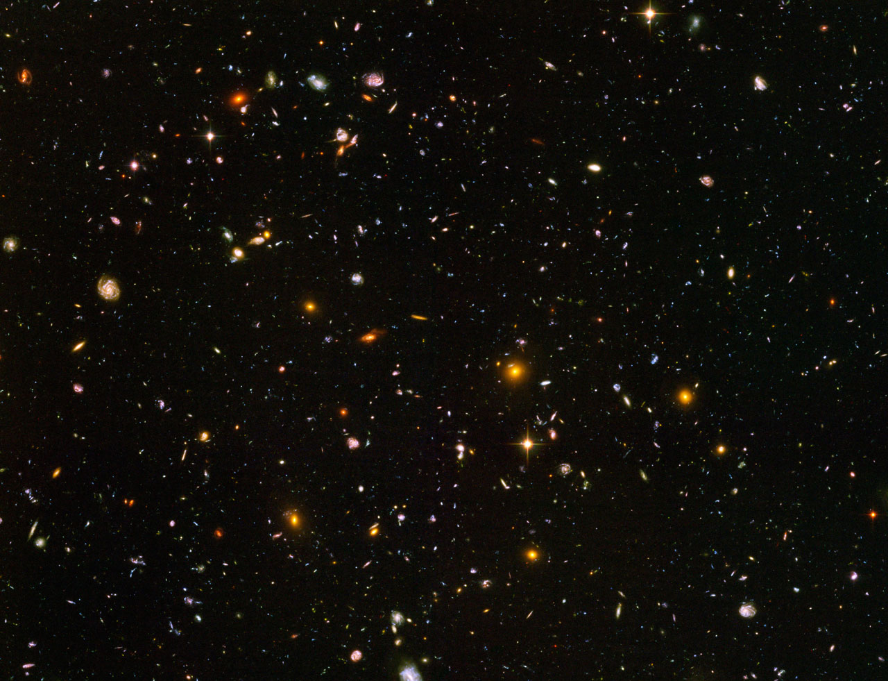
The Evidence &
Empowerment of God
Family Worship Center
Pastor Mark Schwarzbauer PhD

Slide 23

“Almost all religious groups infringe on those liberties and equalities. Whether it be subjugating women, enslaving other races, child abuse, incest, rape and all other forms of atrocities. Yes, by all means practice your faith but that does not allow people the right to shove it in others faces or try to make them live by rules that were made up by an imaginary sky man.”

Slide 24
My answer… “Dear Sara: I was away working but felt your sincere concerns warranted a followup and sincere response. Just as the phrase “separation of church and state” is not in the constitution, your aforementioned crimes are not inherent in Christianity. Christianity has built hospitals, schools, fed and clothed the poor around the world and honored women wherever it has gone. Sara, I am not trying to attack you in this apology. I hope I can actually clarify some thought and leave you with encouragement.

Slide 25
If we wish to entertain the citing of atrocities we must also contrast atheism; the three main atheistic regimes of the twentieth century; Hitler in Nazi Germany, Stalin in Russia, and Mao in China are responsible for more than 100 million deaths not to mention the most violent abuse of women, horrible racism and more crimes against humanity than can be spoken. In one century they have outdone all the religions in all previous history.

Slide 26
No doubt anyone can cite a number of atrocities and lay them at the feet of Christianity. However, Sara there is a very significant difference; Those who would perpetrate such crimes hiding behind “faith” do so antithetically to the teachings of Jesus; Those who commit them under the auspices of atheism do so as a natural extension of atheism.
In kindness Mark”

Slide 27

Foundations that Really Matter
Family Worship Center
Pastor Mark Schwarzbauer PhD

Slide 28

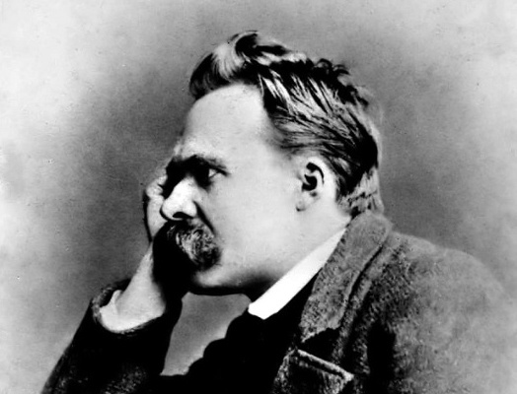
Nietzsche, son of a pastor and grandson of two pastors, God has died philosophically in the nineteenth century. Therefore all Christian morals must be considered dead too. Nietzsche predicted that God being dead would bring 2 things in the 20th century… 1. The 20th century will become the bloodiest century in history 2. A universal madness would break out.

Slide 29
Nietzsche said: "When one gives up the Christian faith, one pulls the right to Christian morality from under one's feet. This morality is by no means self-evident. Christianity is a system, a whole view of things thought out together. By breaking one main concept out of it, the faith in God, one breaks the whole. It stands or falls with faith in God.” (ie If there is no God there is no morality).

Slide 30
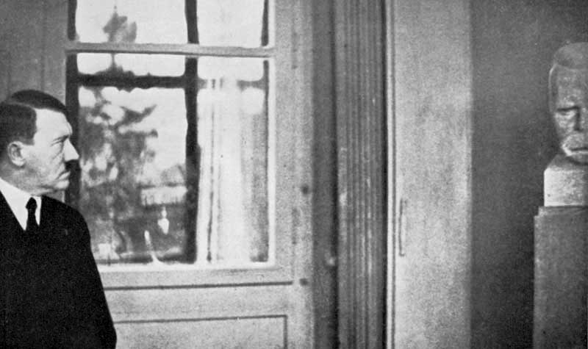
Hitler promoted Nietzsche – Gave his writings to Mussolini & Stahlin

Slide 31
Hitler, Stalin and Mao just fulfilled the natural outworking of true atheism.

Slide 32
Why I am not an atheist-
Summary of Part One
Former atheist Professor Paul Vitz unmasked atheism showing it is actually based in psychological needs and deficiency and not in rational intellectualism. As a social scientist myself, this is one reason I am not atheist.

Slide 33
Why I am not an atheist-
Summary of Part One
People like Martin Bashir who grossly distort the arguments make me skeptical of their skepticism. If it is rational truth the atheist purports why do they depend upon faulty forms of logic to defend it? This is the second reason I am not an atheist.

Slide 34
Why I am not an atheist-
Summary of Part One
Atheists point to the atrocities of religion as a major reason to not believe in God. Yet, in one century atheist regimes have killed more than all religions in all of history combined. Such crimes are antithetical to Christianity and the teachings of Jesus. However, as the leader in atheism Nietzsche has pointed out these atrocities are inherent to atheism. This is another reason I am not an atheist.

