Slide 1
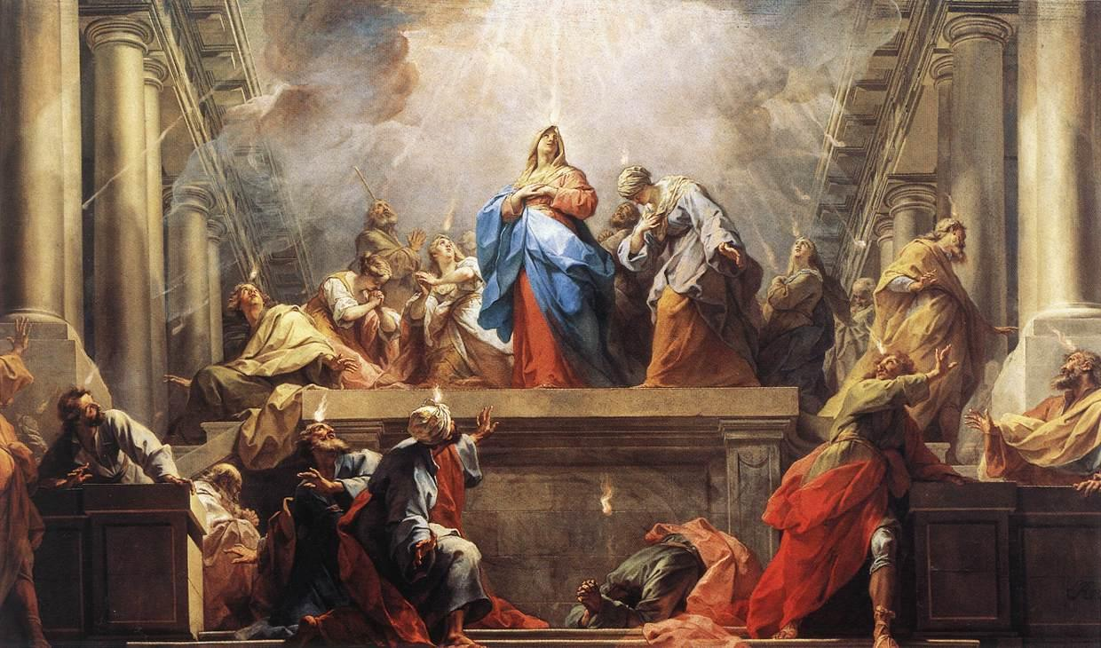
The Sweet Sound of Surrender
Pastor Mark Schwarzbauer PhD
Family Worship Center

Slide 2

Acts 2:1-4
When the Day of Pentecost had fully come, they were all with one accord in one place. ² And suddenly there came a sound from heaven, as of a rushing mighty wind, and it filled the whole house where they were sitting. ³ Then there appeared to them divided tongues, as of fire, and one sat upon each of them. ⁴ And they were all filled with the Holy Spirit and began to speak with other tongues, as the Spirit gave them utterance.

Slide 3
Part One:
The Baptist IN/WITH the Holy Spirit

Slide 4
Pentecost 101
Family Worship Center
Rev. Mark
Schwarzbauer, Ph.D.

Slide 5
Pentecost 102
Q&A
Family Worship Center
Rev. Mark
Schwarzbauer, Ph.D.

Slide 6
The Baptism in the Holy Spirit is in all 4 Gospels and the Book of Acts.

Slide 7
Matthew 3:11
“I indeed baptize you with water unto repentance, but He who is coming after me is mightier than I, whose sandals I am not worthy to carry. He will baptize you with the Holy Spirit.”

Slide 8
Mark 1:8
“I indeed baptized you with water, but He will baptize you with the Holy Spirit.”

Slide 9
Mark 16:17
Jesus was the first to promise speaking in tongues for believers saying “they will speak with new tongues;”

Slide 10
Luke 3:16
“John answered, saying to all, “I indeed baptize you with water; but One mightier than I is coming, whose sandal strap I am not worthy to loose. He will baptize you with the Holy Spirit and fire.”
(Note: Acts 2- the “Tongues” came as “fire”).

Slide 11
John 1:32-33
³²And John bore witness, saying, “I saw the Spirit descending from heaven like a dove, and He remained upon Him. ³³ I did not know Him, but He who sent me to baptize with water said to me, ‘Upon whom you see the Spirit descending, and remaining on Him, this is He who baptizes with the Holy Spirit.’

Slide 12
Acts 1:5
(Jesus said) “for John truly baptized with water, but you shall be baptized with the Holy Spirit not many days from now.”

Slide 13
For the many fulfillments of the Baptism in the Holy Spirit with the initial physical evidence of speaking in other tongues see
Acts 2, 8, 9,10,11,19

Slide 14
The Initial Physical Evidence of the Baptism with the Holy Spirit is always speaking in other tongues. Please see Pentecost 101 and 102. We don’t measure
God’s Word by our experience. We measure our experience by God’s Word.

Slide 15
You receive the Holy Spirit inside of you the moment you are born-again (John 20:22). The experience of the
Baptism in the Holy Spirit is a separate, subsequent experience available for all believers
(Acts 2:39).

Slide 16
Almost one Billion
(1 in every 7 people) is a Pentecostal or Charismatic Christian who believes in and speaks in a prayer language they have never learned.

Slide 17
Fr. Dennis Bennett in his book “How to Pray for the Release of the Holy Spirit” explains how the Baptism in the Holy Spirit is a release of the Holy Spirit who already lives inside of you as a believer.

Slide 18
Part Two:
Why it is Difficult for Some People to Surrender and Release

Slide 19
Barriers to Releasing to the Holy Spirit
Sometimes it is fear that causes us to hold back.
Sometimes it is concern over losing control.
Sometimes it is a misunderstanding of how the release comes.

Slide 20
Closing: If you have already received the Baptism in the Holy Spirit with the initial physical evidence of speaking in tongues then exercise your gift. If you have not received continue seeking God and surrender.

