Slide 1
The Beauty of
Spiritual Language
Pastor Mark Schwarzbauer PhD
Family Worship Center

Slide 3
Isaiah 28:11-12
11 For with stammering lips and another tongue
He will speak to this people,
12 To whom He said, “This is the rest with which You may cause the weary to rest,”
And, “This is the refreshing”;
Yet they would not hear.

Slide 4
Hebrews 6:1-3
“Therefore, leaving the discussion of the elementary principles of Christ, let us go on to perfection, not laying again the foundation of repentance from dead works and of faith toward God, ² of the doctrine of baptisms, of laying on of hands, of resurrection of the dead, and of eternal judgment. ³ And this we will do if God permits.”

Slide 5
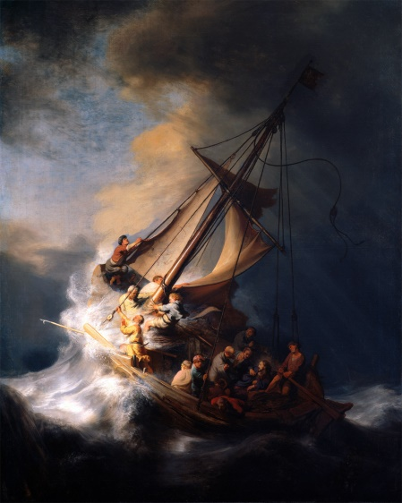
Pastor Mark Schwarzbauer PhD Family Worship Center
Foundation of Repentance
The Lost Art of
Repentance

Slide 6
Repent(ance) ~ Verb (action word) Metanoeo means to change one’s mind and purpose, as the result of acquired knowledge. Used with the cognate noun Metanoia to indicate true repentance. You change your lifestyle to reflect that you have changed your mind to thinking God’s way.

Slide 7
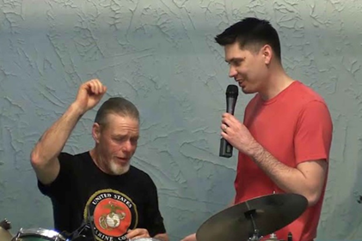
Why Does God Want You to Get Baptized? Pastor Mark Schwarzbauer PhD Family Worship Center

Slide 8
The purpose of water baptism is to symbolize the transformation you have experienced in Christ and to publicly proclaim your personal faith.

Slide 9
Hebrews 6:1-3
“Therefore, leaving the discussion of the elementary principles of Christ, let us go on to perfection, not laying again the foundation of repentance from dead works and of faith toward God, ² of the doctrine of baptisms, of laying on of hands, of resurrection of the dead, and of eternal judgment. ³ And this we will do if God permits.”
The doctrine of baptisms is PLURAL.
The first is baptism in water.
The second is the
baptism in the Holy Spirit.

Slide 10
Myths & Marvels Pastor Mark Schwarzbauer PhD Family Worship Center

Slide 11
The Release and Refreshing of Pentecost Pastor Mark Schwarzbauer PhD Family Worship Center

Slide 12
Part Two: The Baptist IN/WITH the Holy Spirit

Slide 13
Pentecost 101 Pentecost 102 i-fwc.com/Media/archive.html

Slide 14
The Baptism in the Holy Spirit is in all 4 Gospels and the Book of Acts.

Slide 15
Matthew 3:11
“I indeed baptize you with water unto repentance, but He who is coming after me is mightier than I, whose sandals I am not worthy to carry. He will baptize you with the Holy Spirit.”

Slide 16
Mark 1:8
“I indeed baptized you with water, but He will baptize you with the Holy Spirit.”

Slide 17
Mark 16
Jesus was the first in the New Testament to promise speaking in tongues for believers.

Slide 18
Luke 3:16
“John answered, saying to all, “I indeed baptize you with water; but One mightier than I is coming, whose sandal strap I am not worthy to loose. He will baptize you with the Holy Spirit and fire.”

Slide 19
John 1: 32-33
And John bore witness, saying, “I saw the Spirit descending from heaven like a dove, and He remained upon Him. 33 I did not know Him, but He who sent me to baptize with water said to me, ‘Upon whom you see the Spirit descending, and remaining on Him, this is He who baptizes with the Holy Spirit.’

Slide 20
Acts 1:5
(Jesus said) “for John truly baptized with water, but you shall be baptized with the Holy Spirit not many days from now.”

Slide 21
Fr. Dennis Bennett in his book “How to Pray for the Release of the Holy Spirit” explains how the Baptism in the Holy Spirit is a release of the Holy Spirit who already lives inside of you as a believer.

Slide 22
You already have the Holy Spirit in you when you are born again. Therefore, the Baptism in/with the Holy Spirit is not trying to get the Holy Spirit to come to you. The Baptism in the Holy Spirit is releasing the Holy Spirit who is in you to flow through and from you.

Slide 23
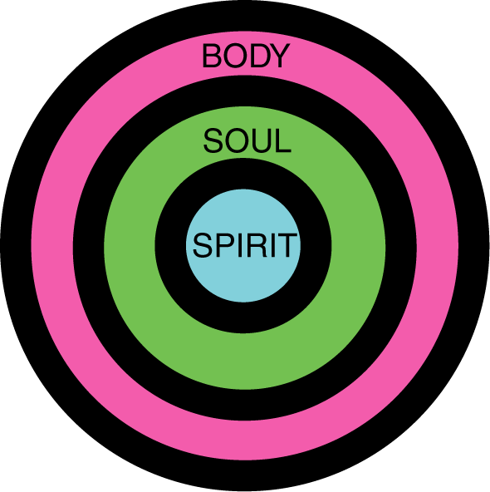
Your 3-Fold Nature
The Baptism in the Holy Spirit is letting the person of the Holy Spirit flow from your spirit through you.

Slide 24
Your 3-Fold Nature
When you let the Holy Spirit into your soul (the psychological part of you) He baptizes your intellect (thoughts), your emotions (feelings), and your will (motivations and desires).

Slide 25
Your 3-Fold Nature
When you let the Holy Spirit into your body (the physical part of you) He gives you strength and health and flows in the prayer language of tongues praying the perfect will of God and building you up.

Slide 26
On this Pentecost Sunday, join our almost one billion brothers and sisters around the world in allowing the Holy Spirit to baptize you and flow through your life.

Slide 27
Part Three: Why it is difficult for some people to release to the Holy Spirit

Slide 28
Barriers to Releasing to the Holy Spirit
Sometimes it is fear that causes us to hold back.
Sometimes it is concern over losing control.
Sometimes it is a misunderstanding of how the release comes.

Slide 29
The barrier of fear that I may be opening myself up to the devil!

Slide 30
Luke 11:9-13
⁹ “So I say to you, ask, and it will be given to you; seek, and you will find; knock, and it will be opened to you. ¹⁰ For everyone who asks receives, and he who seeks finds, and to him who knocks it will be opened. ¹¹ If a son asks for bread from any father among you, will he give him a stone? Or if he asks for a fish, will he give him a serpent instead of a fish? ¹² Or if he asks for an egg, will he offer him a scorpion? ¹³ If you then, being evil, know how to give good gifts to your children, how much more will your heavenly Father give the Holy Spirit to those who ask Him!”

Slide 31
Father will not only protect you, He assures you based on His goodness and calls you to come and ask for the Holy Spirit.

Slide 32
The barrier of concern over losing control.

Slide 33
Barrier Over Losing Control
In America we are very self-conscious and highly resistant to letting go.
Those who come from a chaotic background tend to be controlling to keep peace.
The Spirit is not going to control you. He will not override your free will.

Slide 34
Barrier Over Losing Control
Praying in tongues does not leave a person out of control.
I Cor. 14:32 tells us the “spirits of the prophets are subject to the prophets.”
I Cor. 14:15 tells us it is a matter of the “will” or choice. You control when and where you release the Spirit.

Slide 35
The barrier of misunderstanding

Slide 36
Sometimes we misunderstand and think that God will make us speak; you need to do the speaking. God will not manipulate you or control you.

Slide 37
Reflecting on why it took 3 years for the release of the Holy Spirit in his life, Jack Hayford in The Beauty of Spiritual Language says “I said nothing, because I supposed that speaking in tongues was, well, more a linguistic seizure of some kind, rather than a voluntary point of participation with the Holy Spirit giving utterance. “ page 43

Slide 38
Isaiah 28:11-12
11 For with stammering lips and another tongue
He will speak to this people,
12 To whom He said, “This is the rest with which You may cause the weary to rest,”
And, “This is the refreshing”;
Yet they would not hear.

