Slide 1
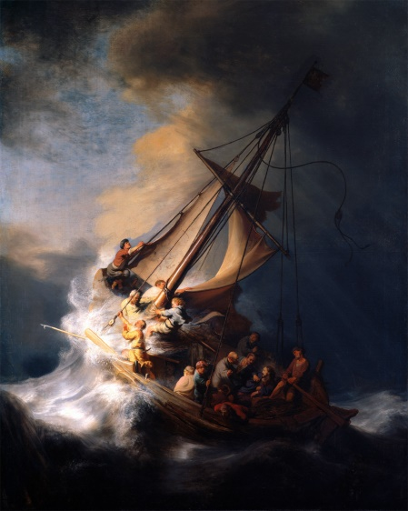
Pastor Mark Schwarzbauer PhD Family Worship Center
Foundation of Repentance
The Lost Art of
Repentance
Part 2

Slide 3
Hebrews 6:1-3
“Therefore, leaving the discussion of the elementary principles of Christ, let us go on to perfection, not laying again the foundation of repentance from dead works and of faith toward God, 2 of the doctrine of baptisms, of laying on of hands, of resurrection of the dead, and of eternal judgment. 3 And this we will do if God permits.”

Slide 4
Repentance
The Verb Metanoeo means to change one’s mind and purpose, as the result of acquired knowledge. Used with Metanoia to indicate true repentance.

Slide 5
True Repentance
True repentance changes the mind and hates sin.
True Repentance leads to a change in your lifestyle.
True repentance grabs hold of God’s mercy in Jesus.

Slide 6
Message of Repentance
Old Testament Judges and Prophets.
The Message of John – Repent and “Produce fruit in keeping with repentance.” Matthew 3:8.
The Message of Jesus – Matthew 4 called people to repent.
Paul in Acts 17:30 “In the past God overlooked such ignorance, but now he commands all people everywhere to repent.”

Slide 7
Everyone Needs Repentance
Rev. 2:5 “Consider how far you have fallen! Repent and do the things you did at first. If you do not repent, I will come to you and remove your lampstand from its place.”
Written to the church in Ephesus and represents us at times too.
Repentance is to move us back into living how God wants us to live.

Slide 9
Something has been stolen from YOU too!

Slide 10
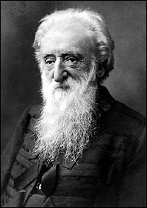
William Booth who founded the Salvation Army

Slide 11
The chief danger that confronts the coming century will be religion without the Holy Ghost, Christianity without Christ, forgiveness without repentance, salvation without regeneration, politics without God, heaven without hell.”

Slide 13
Repentance isn’t negative, although you should feel bad about your sin, repentance leads to great joy and power.

Slide 14
You are Empowered through Repentance- calling sin what it is… “sin” gives you the power to repent and change. GOOD NEWS!

Slide 15
Restoring Joy by Repentance
“Restore to me the joy of your salvation.” (Psalm 51:12)
Cleansing through repentance changes not only your past but your future!

Slide 16
Refreshing… Acts 3:19 “Repent, then, and turn to God, so that your sins may be wiped out, that times of refreshing may come from the Lord,”

Slide 17
II Chronicles 7:14 “if My people who are called by My name will humble themselves, and pray and seek My face,
and turn from their wicked ways, then I will hear from heaven, and will forgive their sin and heal their land.”

Slide 19
Comedian Anna Russell’s “Psychiatric Folksong”
I went to my psychiatrist to be psychoanalyzed
To find out why I killed the cat and
blacked my husband’s eye.
He laid me on a downy couch to see what he could find,
And here’s what he dredged up, from my subconscious mind.
When I was one, my mummy hid my dolly in a trunk
And so it follows, naturally, that I am always drunk.

Slide 20
When I was two, I saw my father
kiss the maid one day,
and that is why I suffer from
kleptomania.
At three I had a feeling of ambivalence towards my brothers,
and so it follows naturally I poisoned
all my lovers.
But I am happy now I have learned the lessons this has taught:
Everything I do that’s wrong,
is someone else’s fault!

Slide 21
The new repository for blame…
“I’m not guilty, I’m just sick!”

Slide 22
WFAA – Dallas aired the CNN Report

Slide 23
It is popular to look for an environmental or obscure medical scapegoat to relieve people of taking any personal responsibility.

Slide 24
Personal Responsibility
Romans 14:12 “So then each of us shall give account of himself to God.”
We are free moral agents - Joshua 24:15.

Slide 25
Pastor Mark Schwarzbauer PhD Family Worship Center

Slide 26
Why I am not an atheist Part 3: Free Will Pastor Mark Schwarzbauer PhD Family Worship Center

Slide 27
The Good News is…
You really
can change.

Slide 28
I Corinthians 6:9-11
⁹Do you not know that the unrighteous will not inherit the kingdom of God? Do not be deceived. Neither fornicators, nor idolaters, nor adulterers, nor homosexuals, nor sodomites, ¹⁰ nor thieves, nor covetous, nor drunkards, nor revilers, nor extortioners will inherit the kingdom of God. ¹¹ And such were some of you. But you were washed, but you were sanctified, but you were justified in the name of the Lord Jesus and by the Spirit of our God.

Slide 29
I Corinthians 6:9-11
⁹Do you not know that the unrighteous will not inherit the kingdom of God? Do not be deceived. Neither fornicators, nor idolaters, nor adulterers, nor homosexuals, nor sodomites, ¹⁰ nor thieves, nor covetous, nor drunkards, nor revilers, nor extortioners will inherit the kingdom of God. ¹¹ And such were some of you. But you were washed, but you were sanctified, but you were justified in the name of the Lord Jesus and by the Spirit of our God.

Slide 30
Repentance – gives you back the power for real change.
There are organic brain diseases and real organic psychological illnesses. However, in absence of true organic brain disorders to call wrong behavior “sickness” instead of what is really is “sin”, cripples the person.

Slide 31
Repentance – gives you back the power for real change.
You can’t repent of “sickness” but you can repent and overcome “sin.”

Slide 32
Dr. Hobart Mowrer
“For several decades we psychologists looked upon the whole matter of sin and moral accountability as a great incubus and acclaimed our liberation from it as epoch making. But at length we have discovered that to be free in this sense, that is, to have the excuse of being sick rather than sinful, is to court the danger of also becoming lost.

Slide 33
Dr. Hobart Mowrer
This danger is, I believe, betokened by the widespread interest in existentialism, which we are presently witnessing. In becoming amoral, ethically neutral and free, we have cut the very roots of our being, lost our deepest sense of selfhood and identity, and with neurotics, themselves, we find ourselves asking, “Who am I, what is my deepest destiny, what does living mean?”

Slide 34
It is time to repent - face our problems and confess our sins and turn to God for forgiveness
and healing.

Slide 35
Jesus took your sin upon himself to set you free (Col. 2). He offers Salvation by His completed work.

Slide 36
We are called to “repent and believe” Mark 1:15, Luke 24:47, Acts 2:38, 3:19, 17:30, 20:21, 26:20 et al.

