Slide 1
Pastor Mark Schwarzbauer PhD Family Worship Center

Slide 2
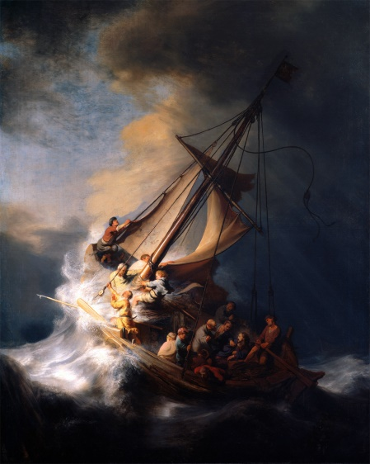
Pastor Mark Schwarzbauer PhD Family Worship Center
Foundation of Repentance
The Lost Art of
Repentance

Slide 3
Hebrews 6:1-3
“Therefore, leaving the discussion of the elementary principles of Christ, let us go on to perfection, not laying again the foundation of repentance from dead works and of faith toward God, 2 of the doctrine of baptisms, of laying on of hands, of resurrection of the dead, and of eternal judgment. 3 And this we will do if God permits.”

Slide 5
Hebrews 6:1-3
“Therefore, leaving the discussion of the elementary principles of Christ, let us go on to perfection, not laying again the foundation of repentance from dead works and of faith toward God, 2 of the doctrine of baptisms, of laying on of hands, of resurrection of the dead, and of eternal judgment. 3 And this we will do if God permits.”

Slide 6
Repentance
There are three Greek words used in the New Testament to denote repentance and meanings have important differences. (Easton’s Bible Dictionary)

Slide 7
Repentance
They are all based on “meta” meaning “change afterwards” and “nous” referring to the mind.

Slide 8
Repentance
ONE- The verb metamelomai is used of a change of mind, such as to produce regret or even remorse on account of sin, but not necessarily a change of heart.

Slide 9
II Corinthians 7:10
“Godly sorrow brings repentance that leads to salvation and leaves no regret, but worldly sorrow brings death.”

Slide 10
Worldly sorrow is being sorry for being caught, maybe for what resulted, perhaps even somewhat sorry for they’ve done; but not sorry enough to want to change.

Slide 11
Repentance
TWO- The Verb Metanoeo means to change one’s mind and purpose, as the result of acquired knowledge. Used with Metanoia to indicate true repentance.

Slide 12
Repentance
THREE- Cognate noun metanoia is a change of mind and purpose and life.

Slide 13
True Repentance
True repentance changes the mind and hates sin.
True Repentance leads to a change in your lifestyle.
True repentance grabs hold of God’s mercy in Jesus.

Slide 14
Message of Repentance
Old Testament Judges and Prophets.
The Message of John – Repent and “Produce fruit in keeping with repentance.” Matthew 3:8.
The Message of Jesus – Matthew 4 called people to repent.
Paul in Acts 17:30 “In the past God overlooked such ignorance, but now he commands all people everywhere to repent.”

Slide 15
Everyone Needs Repentance
Rev. 2:5 “Consider how far you have fallen! Repent and do the things you did at first. If you do not repent, I will come to you and remove your lampstand from its place.”
Written to the church in Ephesus and represents us at times too.
Repentance is to move us back into living how God wants us to live.

Slide 17
Something has been stolen from YOU too!

Slide 18
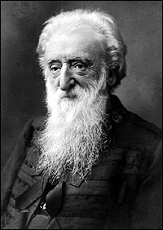
William Booth who founded the Salvation Army

Slide 19
The chief danger that confronts the coming century will be religion without the Holy Ghost, Christianity without Christ, forgiveness without repentance, salvation without regeneration, politics without God, heaven without hell.”

Slide 21
Repentance isn’t negative, although you should feel bad about your sin, repentance leads to great joy and power.

Slide 22
You are Empowered through Repentance- calling sin what it is… “sin” gives you the power to repent and change. GOOD NEWS!

Slide 23
Restoring Joy by Repentance
“Restore to me the joy of your salvation.” (Psalm 51:12)
Cleansing through repentance changes not only your past but your future!

Slide 24
Refreshing… Acts 3:19 “Repent, then, and turn to God, so that your sins may be wiped out, that times of refreshing may come from the Lord,”

Slide 25
II Chronicles 7:14 “if My people who are called by My name will humble themselves, and pray and seek My face,
and turn from their wicked ways, then I will hear from heaven, and will forgive their sin and heal their land.”

Slide 26
Our Theme for 2016

