Slide 1
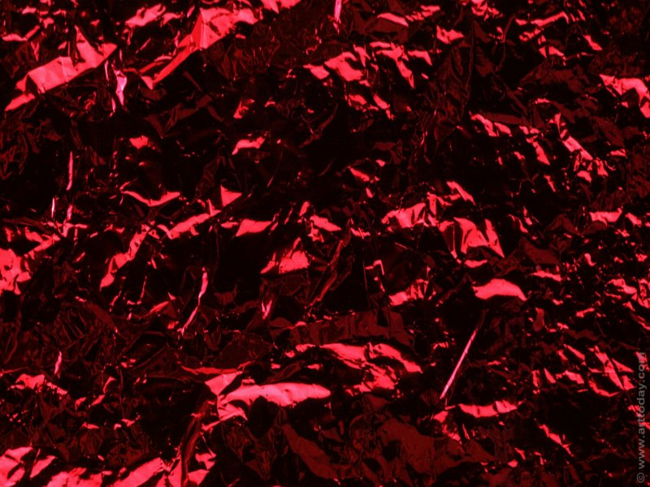

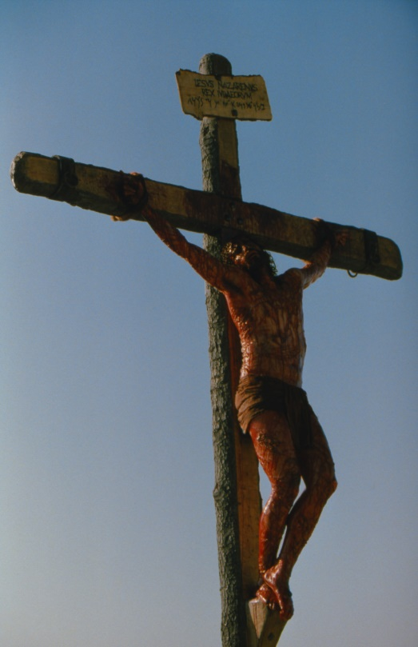
Foundation of the Fall and Redemption
Pastor Mark Schwarzbauer, Ph.D.
Family Worship Center

Slide 2
Text: I Timothy 2:5-6
    “For there is one God and one Mediator between God and men, the Man Christ Jesus, ⁶who gave Himself a ransom for all, to be testified in due time.”

Slide 3
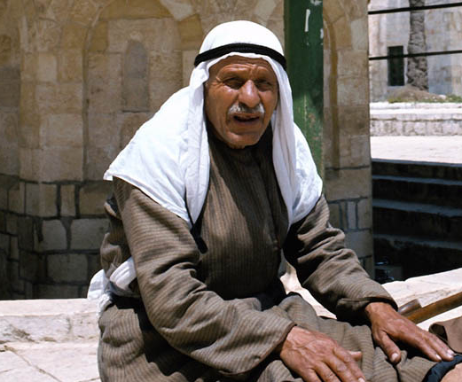
Part One: The
Mess We
Made

Slide 4
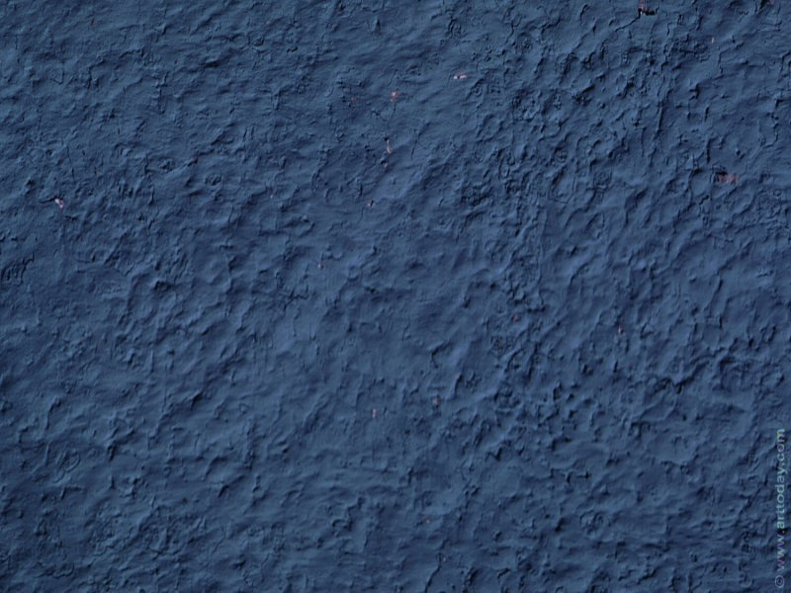
Foundational Truth - Man was created good and upright; for God said, “Let us make man in our own image, after our likeness.” However, man by voluntary transgression fell and thereby incurred not only physical death but also spiritual death, which is separation from God.

Slide 5
“I keep trying to find a life, on my own apart from You. I am the king of excuses, I've got one for every selfish thing I do. What's going on inside of me? I despise my own behavior. This only serves to confirm my suspicions that I'm still a man in need of a Savior Charlie Peacock ©1991 (also sung by DC Talk)

Slide 6
Foundational Truth - Man's only hope of redemption is through the shed blood of Jesus Christ the Son of God.

Slide 7
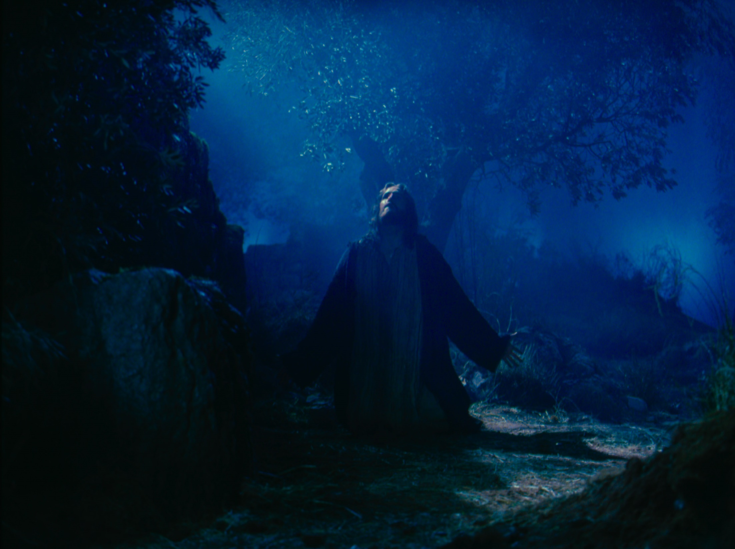
Part Two:
The Mediator
Who Cleans Up Your Mess

Slide 8

The Mediator
From the Greek Word  ( \
Meaning a go–between (from  middle, and  to go).
one who stands in the middle, one who speaks to both, or one who causes arguments to cease.

Slide 9
Text: I Timothy 2:5-6
    “For there is one God and one Mediator between God and men, the Man Christ Jesus, ⁶who gave Himself a ransom for all, to be testified in due time.”

Slide 10

There is only one mediator representing
God to us and us to God

Slide 11
John 1:14
The Word became flesh and dwelt among us…

Slide 12
Only by possessing both deity & humanity could He represent the claims of the one and relate to the needs of the other

Slide 13
Hebrews 9:14-15
“14 how much more shall the blood of Christ, who through the eternal Spirit offered Himself without spot to God, cleanse your conscience from dead works to serve the living God? 15 And for this reason He is the Mediator of the new covenant, by means of death, for the redemption of the transgressions under the first covenant, that those who are called may receive the promise of the eternal inheritance.”

Slide 14
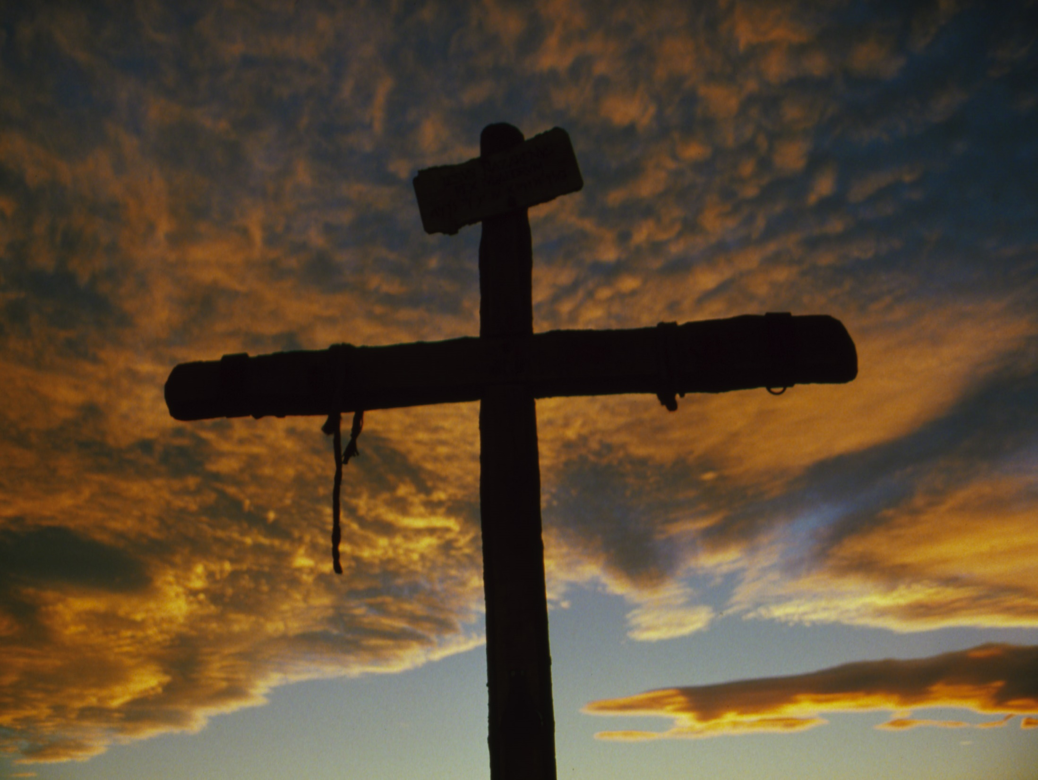
Part Three:
The Missing Savior

Slide 15
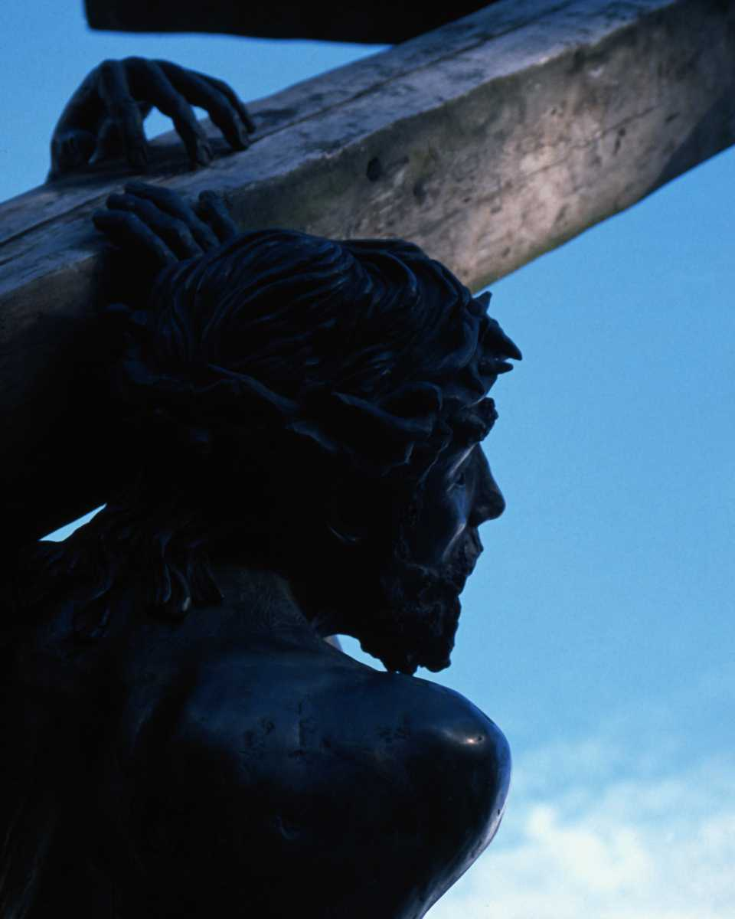
Are you missing a savior in your life?

