Slide 1
Pastor Mark Schwarzbauer PhD Family Worship Center

Slide 2
Part One:

Slide 3
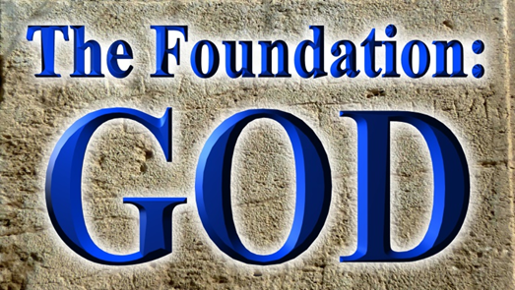
Pastor Mark Schwarzbauer PhD Family Worship Center

Slide 4
Genesis 1:1-5
1 In the beginning God created the heavens and the earth. 2 The earth was without form, and void; and darkness was on the face of the deep. And the Spirit of God was hovering over the face of the waters.

Slide 5
Genesis 1:1-5
1 In the beginning God created the heavens and the earth. 2 The earth was without form, and void; and darkness was on the face of the deep. And the Spirit of God was hovering over the face of the waters.

Slide 6
Genesis 1:1-5
3 Then God said, “Let there be light”; and there was light. 4 And God saw the light, that it was good; and God divided the light from the darkness. 5 God called the light Day, and the darkness He called Night. So the evening and the morning were the first day.

Slide 7
John 1:1-3
Genesis 1:1-5
3 Then God said, “Let there be light”;
In the beginning was the Word, and the Word was with God, and the Word was God. 2 He was in the beginning with God. 3 All things were made through Him, and without Him nothing was made that was made.

Slide 8
Genesis 1:1-5
1 In the beginning God created the heavens and the earth. 2 The earth was without form, and void; and darkness was on the face of the deep. And the Spirit of God was hovering over the face of the waters. 3 Then God said, “Let there be light”;
In Genesis 1:1, 2 and 3
God begins revealing the
three persons of the Godhead.

Slide 9
Genesis 1:1-5
1 In the beginning God created the heavens and the earth. 2 The earth was without form, and void; and darkness was on the face of the deep. And the Spirit of God was hovering over the face of the waters. 3 Then God said, “Let there be light”;
In Genesis 1:1, 2 and 3
God begins revealing the
three persons of the Godhead.
The Foundation of WHO He is.

Slide 10
Genesis 1:1-5
3 Then God said, “Let there be light”; and there was light. 4 And God saw the light, that it was good;

Slide 11
Genesis 1:1-5
3 Then God said, “Let there be light”; and there was light. 4 And God saw the light, that it was good;
James 1:17
Every good gift and every perfect gift is from above, and comes down from the Father of lights, with whom there is no variation or shadow of turning.

Slide 12
Genesis 1:1-5
3 Then God said, “Let there be light”; and there was light. 4 And God saw the light, that it was good;
James 1:17
Every good gift and every perfect gift is from above, and comes down from the Father of lights, with whom there is no variation or shadow of turning.
The Foundation of WHAT He is.

Slide 13
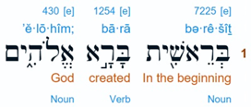
Genesis 1:26a
Then God said, “Let Us make man in Our image, according to Our likeness;”…
“God” here in Hebrew is “Elohim” which is the plural of “Eloah”, “im” makes it a masculine plural noun.

Slide 14
Genesis 1:26a
Then God said, “Let Us make man in Our image, according to Our likeness;”…
“God” here in Hebrew is “Elohim” which is the plural of “Eloah”, “im” makes it a masculine plural noun.

Slide 15
Genesis 1:26a
Then God said, “Let Us make man in Our image, according to Our likeness;”…
In the very first chapter God reveals Himself as triune tri(three) une (unity) (one God eternally existent in 3 persons) (not triplex NOT 3 Gods).

Slide 16
Deuteronomy 6:4
Hear, O Israel: The Lord our God, the Lord is one!

Slide 17
Deuteronomy 6:4
Hear, O Israel: The Lord our God, the Lord is one!
The Jews will recite Adonai (Lord) instead of saying Yahweh (LORD). Yahweh is the holy name of God from the tetra gammon.

Slide 18
Deuteronomy 6:4
Hear, O Israel: The Lord our God, the Lord is one!
YHWH 4 aspirate (breathing) consonants. Every breath you speak the creators name who gave you your breath. When you can no longer speak His name… you die.

Slide 19
Deuteronomy 6:4
Hear, O Israel: The Lord our God, the Lord is one!

Slide 20
Deuteronomy 6:4
Hear, O Israel: The Lord our God, the Lord is one!
In Hebrew “yachid” means “absolute one.” Hebrew “echad” means “united one.” – the word here for “one” is “echad” meaning not an “absolute one” but a “united one”.

Slide 21
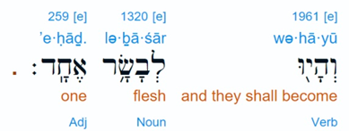
Genesis 2:24
…and they shall be one flesh (“echad”)
God reveals Himself as a UNITED ONE
http://www.hebrew4christians.com/Scripture/Torah/The_Shema/the_shema.html

Slide 22
Ever since Genesis 3:15 the serpent has tried everything to distort, defame and bring rejection of the promised redeemer.

Slide 23
Psalm 118:22-23
²²“The stone which the builders rejected Has become the chief cornerstone. ²³This was the LORD’s doing; It is marvelous in our eyes.”

Slide 24
Isaiah 28:16
So this is what the Sovereign LORD says: “See, I lay a stone in Zion, a tested stone, a precious cornerstone for a sure foundation; the one who trusts will never be dismayed.

Slide 25
Part Two:

Slide 26
Luke 22:66-71
66 As soon as it was day, the elders of the people, both chief priests and scribes, came together and led Him into their council, saying, 67 “If You are the Christ, tell us.”

Slide 27
Luke 22:66-71
But He said to them, “If I tell you, you will by no means believe. 68 And if I also ask you, you will by no means answer Me or let Me go. 69 Hereafter the Son of Man will sit on the right hand of the power of God.”

Slide 28
Luke 22:66-71
70 Then they all said, “Are You then the Son of God?”
So He said to them, “You rightly say that I am.”
71 And they said, “What further testimony do we need? For we have heard it ourselves from His own mouth.”

Slide 29
The Amazing claim to be “the Son of God.”
They recognized the phrase “the Son of man will sit on the right hand of the power of God” represented the ultimate power and authority of God.
Jesus was claiming effectual deity (also seen in His forgiving sin Matt. 9).
The direct ? “Are you then the Son of God?”
Jesus answers “You rightly say that I am.”
Jesus was claiming essential deity.

Slide 30
The Amazing Implication
John 10:33 33 The Jews answered Him, saying, “For a good work we do not stone You, but for blasphemy, and because You, being a Man, make Yourself God.”
The Jews fully understood the implication.
Not only did He clearly claim to be God in the flesh, He specifically stated that He was the ONLY way to get to heaven, John 14:6.

Slide 31
The Amazing Incarnation-IMMANUEL – Is. 7:14 / Mat. 1:23
John 1:1 God was the Word.
John 8:58… I AM- Exodus 3:14.
John 14:8-9 “he who has seen Me has seen the Father.”
John 20:28 Thomas “my Lord and my God”. Jesus accepts his worship.
Colossians 2:9 “the fullness of the godhead bodily.”
Revelation- Alpha and Omega, EMET.

Slide 32
The Amazing Incarnation-
Isaiah 44:6, LORD = YAHWAH First and last. Besides me there is no God.
Revelation 1:8, Alpha and Omega, Beginning & End, ALMIGHTY.
Rev. 1:11- Alpha & Omega, First & Last.
Rev. 1:17-18 First and Last, WHO died! (Jesus is the one who died!).
These are the words of Jesus clearly declaring Himself to be YAHWAH GOD

Slide 33
John 5:39-40
“ 39 You search the Scriptures, for in them you think you have eternal life; and these are they which testify of Me. 40 But you are not willing to come to Me that you may have life.”

Slide 34
Don’t let anyone undermine your foundation of who Jesus Christ really is.

