Slide 1
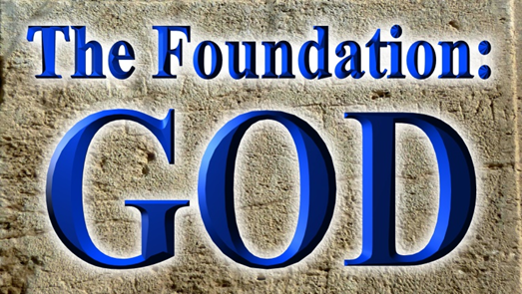
Pastor Mark Schwarzbauer PhD Family Worship Center

Slide 2
Genesis 1:1-5
1 In the beginning God created the heavens and the earth. 2 The earth was without form, and void; and darkness was on the face of the deep. And the Spirit of God was hovering over the face of the waters.

Slide 3
Genesis 1:1-5
3 Then God said, “Let there be light”; and there was light. 4 And God saw the light, that it was good; and God divided the light from the darkness. 5 God called the light Day, and the darkness He called Night. So the evening and the morning were the first day.

Slide 4
Part One:

Slide 5
Genesis 1:1-5
1 In the beginning God created the heavens and the earth. 2 The earth was without form, and void; and darkness was on the face of the deep. And the Spirit of God was hovering over the face of the waters.

Slide 6
Genesis 1:1-5
1 In the beginning God created the heavens and the earth. 2 The earth was without form, and void; and darkness was on the face of the deep. And the Spirit of God was hovering over the face of the waters.

Slide 7
Genesis 1:1-5
3 Then God said, “Let there be light”; and there was light. 4 And God saw the light, that it was good; and God divided the light from the darkness. 5 God called the light Day, and the darkness He called Night. So the evening and the morning were the first day.

Slide 8
John 1:1-3
Genesis 1:1-5
3 Then God said, “Let there be light”;
In the beginning was the Word, and the Word was with God, and the Word was God. 2 He was in the beginning with God. 3 All things were made through Him, and without Him nothing was made that was made.

Slide 9
Genesis 1:1-5
1 In the beginning God created the heavens and the earth. 2 The earth was without form, and void; and darkness was on the face of the deep. And the Spirit of God was hovering over the face of the waters. 3 Then God said, “Let there be light”;
In Genesis 1:1, 2 and 3
God begins revealing the
three persons of the Godhead.

Slide 10
Genesis 1:1-5
1 In the beginning God created the heavens and the earth. 2 The earth was without form, and void; and darkness was on the face of the deep. And the Spirit of God was hovering over the face of the waters. 3 Then God said, “Let there be light”;
In Genesis 1:1, 2 and 3
God begins revealing the
three persons of the Godhead.
The Foundation of WHO He is.

Slide 11
Genesis 1:1-5
3 Then God said, “Let there be light”; and there was light. 4 And God saw the light, that it was good;

Slide 12
Genesis 1:1-5
3 Then God said, “Let there be light”; and there was light. 4 And God saw the light, that it was good;
James 1:17
Every good gift and every perfect gift is from above, and comes down from the Father of lights, with whom there is no variation or shadow of turning.

Slide 13
Genesis 1:1-5
3 Then God said, “Let there be light”; and there was light. 4 And God saw the light, that it was good;
James 1:17
Every good gift and every perfect gift is from above, and comes down from the Father of lights, with whom there is no variation or shadow of turning.
The Foundation of WHAT He is.

Slide 14
Genesis 1:26a
Then God said, “Let Us make man in Our image, according to Our likeness;”…

Slide 15
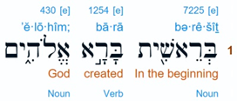
Genesis 1:26a
Then God said, “Let Us make man in Our image, according to Our likeness;”…
“God” here in Hebrew is “Elohim” which is the plural of “Eloah”, “im” makes it a masculine plural noun.

Slide 16
Genesis 1:26a
Then God said, “Let Us make man in Our image, according to Our likeness;”…
“God” here in Hebrew is “Elohim” which is the plural of “Eloah”, “im” makes it a masculine plural noun.

Slide 17
Genesis 1:26a
Then God said, “Let Us make man in Our image, according to Our likeness;”…
In the very first chapter God reveals Himself as triune tri(three) une (unity) (one God eternally existent in 3 persons) (not triplex NOT 3 Gods).

Slide 18
Deuteronomy 6:4
Hear, O Israel: The Lord our God, the Lord is one!

Slide 19
Deuteronomy 6:4
Hear, O Israel: The Lord our God, the Lord is one!
The Jews will recite Adonai (Lord) instead of saying Yahweh (LORD). Yahweh is the holy name of God from the tetra gammon.

Slide 20
Deuteronomy 6:4
Hear, O Israel: The Lord our God, the Lord is one!
YHWH 4 aspirate (breathing) consonants. Every breath you speak the creators name who gave you your breath. When you can no longer speak His name… you die.

Slide 21
Deuteronomy 6:4
Hear, O Israel: The Lord our God, the Lord is one!

Slide 22
Deuteronomy 6:4
Hear, O Israel: The Lord our God, the Lord is one!
In Hebrew “yachid” means “absolute one.” Hebrew “echad” means “united one.” – the word here for “one” is “echad” meaning not an “absolute one” but a “united one”.

Slide 23
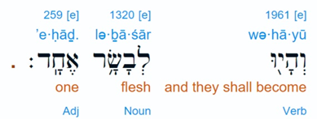
Genesis 2:24
…and they shall be one flesh (“echad”)
God reveals Himself as a UNITED ONE
http://www.hebrew4christians.com/Scripture/Torah/The_Shema/the_shema.html

Slide 24
He clearly states there is NO other God PERIOD.
Isaiah 43:10-11 “You are My witnesses,” says the Lord, “And My servant whom I have chosen, That you may know and believe Me, And understand that I am He. Before Me there was no God formed, Nor shall there be after Me.

Slide 25
He clearly states there is NO other God PERIOD.
Isaiah 44:6,8b “Thus says the Lord, the King of Israel, And his Redeemer, the Lord of hosts: ‘I am the First and I am the Last; Besides Me there is no God.
8b Is there a God besides Me? Indeed there is no other Rock; I know not one.’”

Slide 26
Part Two:

Slide 27
The God of Your Foundation
Having an accurate and clear understanding of
who God is remains essential to developing a real relationship with Him.

Slide 28
Genesis 1:1-5
1 In the beginning God created the heavens and the earth.

Slide 29
Genesis 1:1-5
1 In the beginning God created the heavens and the earth.
He is YOUR creator…
You are special to Him and He knows what is best for you.

Slide 30
Genesis 1:1-5
2 The earth was without form, and void; and darkness was on the face of the deep. And the Spirit of God was hovering over the face of the waters.

Slide 31
Genesis 1:1-5
2 The earth was without form, and void; and darkness was on the face of the deep. And the Spirit of God was hovering over the face of the waters.
When you are without form and void experiencing darkness in your depth… you may feel God is far away. BUT the Spirit of God is right there for you.

Slide 32
Genesis 1:1-5
3 Then God said, “Let there be light”; and there was light.

Slide 33
Genesis 1:1-5
3 Then God said, “Let there be light”; and there was light.
When God speaks light comes… and you need His Word every day to bring light into your life.

Slide 34
Genesis 1:1-5
4 And God saw the light, that it was good; and God divided the light from the darkness.

Slide 35
Genesis 1:1-5
4 And God saw the light, that it was good; and God divided the light from the darkness.
God created it all good. Man is the one under the influence of the devil who messes it up. God isn’t the one to blame. He is the One to turn to for fixing it and you.

