Slide 1
The Beauty of
Spiritual Language
Pastor Mark Schwarzbauer PhD
Family Worship Center

Slide 2
Zephaniah 3:9
“For then I will restore to the peoples a pure language,
That they all may call on the name of the Lord,
To serve Him with one accord.

Slide 3
Hebrews 6:1-3
“Therefore, leaving the discussion of the elementary principles of Christ, let us go on to perfection, not laying again the foundation of repentance from dead works and of faith toward God, ² of the doctrine of baptisms, of laying on of hands, of resurrection of the dead, and of eternal judgment. ³ And this we will do if God permits.”

Slide 4
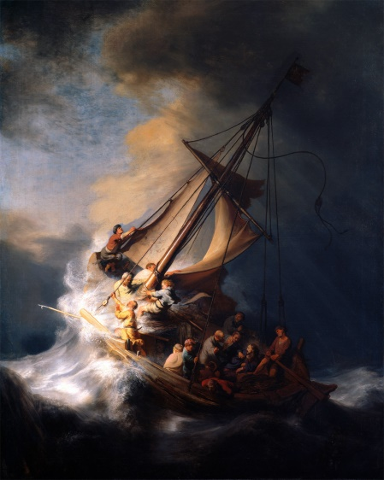
Pastor Mark Schwarzbauer PhD Family Worship Center
Foundation of Repentance
The Lost Art of
Repentance

Slide 5
Repent(ance) ~ Verb (action word) Metanoeo means to change one’s mind and purpose, as the result of acquired knowledge. Used with the cognate noun Metanoia to indicate true repentance. You change your lifestyle to reflect that you have changed your mind to thinking God’s way.

Slide 6
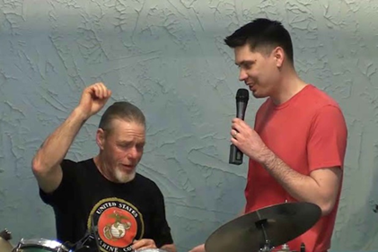
Why Does God Want You to Get Baptized? Pastor Mark Schwarzbauer PhD Family Worship Center

Slide 7
The purpose of water baptism is to symbolize the transformation you have experienced in Christ and to publicly proclaim your personal faith.

Slide 8
Hebrews 6:1-3
“Therefore, leaving the discussion of the elementary principles of Christ, let us go on to perfection, not laying again the foundation of repentance from dead works and of faith toward God, ² of the doctrine of baptisms, of laying on of hands, of resurrection of the dead, and of eternal judgment. ³ And this we will do if God permits.”
The doctrine of baptisms is PLURAL.
The first is baptism in water.
The second is the
baptism in the Holy Spirit.

Slide 9
Myths & Marvels Pastor Mark Schwarzbauer PhD Family Worship Center

Slide 11
Part Two: The Baptist IN/WITH the Holy Spirit

Slide 12
i-fwc.com/Media/archive.html

Slide 13
The Baptism in the Holy Spirit is in all 4 Gospels and the Book of Acts.

Slide 14
Fr. Dennis Bennett in his book “How to Pray for the Release of the Holy Spirit” explains how the Baptism in the Holy Spirit is a release of the Holy Spirit who already lives inside of you as a believer.

Slide 15
You already have the Holy Spirit in you when you are born again. Therefore, the Baptism in/with the Holy Spirit is not trying to get the Holy Spirit to come to you. The Baptism in the Holy Spirit is releasing the Holy Spirit who is in you to flow through and from you.

Slide 16
On Pentecost Sunday, I encouraged you to join our almost one billion brothers and sisters around the world in allowing the Holy Spirit to baptize you and flow through your life.

Slide 17
Part Three: Why it is difficult for some people to release to the Holy Spirit

Slide 18
Barriers to Releasing to the Holy Spirit
Sometimes it is fear that causes us to hold back.
Sometimes it is concern over losing control.
Sometimes it is a misunderstanding of how the release comes.

Slide 19
The barrier of fear that I may be opening myself up to the devil!

Slide 20
Luke 11:9-13
⁹ “So I say to you, ask, and it will be given to you; seek, and you will find; knock, and it will be opened to you. ¹⁰ For everyone who asks receives, and he who seeks finds, and to him who knocks it will be opened. ¹¹ If a son asks for bread from any father among you, will he give him a stone? Or if he asks for a fish, will he give him a serpent instead of a fish? ¹² Or if he asks for an egg, will he offer him a scorpion? ¹³ If you then, being evil, know how to give good gifts to your children, how much more will your heavenly Father give the Holy Spirit to those who ask Him!”

Slide 21
Father will not only protect you, He assures you based on His goodness and calls you to come and ask for the Holy Spirit.

Slide 22
The barrier of concern over losing control.

Slide 23
Barrier Over Losing Control
In America we are very self-conscious and highly resistant to letting go.
Those who come from a chaotic background tend to be controlling to keep peace.
The Spirit is not going to control you. He will not override your free will.

Slide 24
Barrier Over Losing Control
Praying in tongues does not leave a person out of control.
I Cor. 14:32 tells us the “spirits of the prophets are subject to the prophets.”
I Cor. 14:15 tells us it is a matter of the “will” or choice. You control when and where you release the Spirit.

Slide 25
The barrier of misunderstanding

Slide 26
Sometimes we misunderstand and think that God will make us speak; you need to do the speaking. God will not manipulate you or control you.

Slide 27
Reflecting on why it took 3 years for the release of the Holy Spirit in his life, Jack Hayford in The Beauty of Spiritual Language says “I said nothing, because I supposed that speaking in tongues was, well, more a linguistic seizure of some kind, rather than a voluntary point of participation with the Holy Spirit giving utterance. “ page 43

Slide 28
Part Four: The Beauty of Spiritual Language

Slide 29
Isaiah 28:11-12
11 For with stammering lips and another tongue
He will speak to this people,
12 To whom He said, “This is the rest with which You may cause the weary to rest,”
And, “This is the refreshing”;
Yet they would not hear.

Slide 30
Zephaniah 3:9
“For then I will restore to the peoples a pure language,
That they all may call on the name of the Lord,
To serve Him with one accord.

Slide 31
The Distortion of Language By Men
God gave the first language and it was totally pure.
Man messed up language at the fall introducing vulgarity, put downs, sarcasm, inappropriate comments and lewd statements.
At Babel, language needed to be confused to prevent destructive forces from unifying.

Slide 32
The Restoration of Language by God
God’s promise in Zephaniah 3:8 to restore a pure language is fulfilled in tongues where the Holy Spirit gives us pure Spirit led language in both earthly and heavenly languages.
Spiritual language is pure. There is no cursing or inappropriate language praying, worshipping or speaking in tongues.

Slide 33
The Restoration of Language by God
The Spirit prays through you (although you cooperate in actually speaking).

Slide 34
Zephaniah 3:9
“For then I will restore to the peoples a pure language,
That they all may call on the name of the Lord,
To serve Him with one accord.
“they may call on the name of the Lord” is reflected in I Corinthians 14:2 “For he who speaks in a tongue does not speak to men but to God…”

Slide 35
Zephaniah 3:9
“For then I will restore to the peoples a pure language,
That they all may call on the name of the Lord,
To serve Him with one accord.
“To serve Him with one accord” is reflected in I Cor. 12-14 where the gifts of the Spirit are part of the church building each other up in the unity of the Spirit.

Slide 36
Zephaniah 3:9
“For then I will restore to the peoples a pure language,
That they all may call on the name of the Lord,
To serve Him with one accord.
The spiritual language of speaking in tongues is pure and Spirit directed, that’s why it refreshes you so much.

Slide 37
The restoration starts with restoring your relationship to God.

