Slide 1
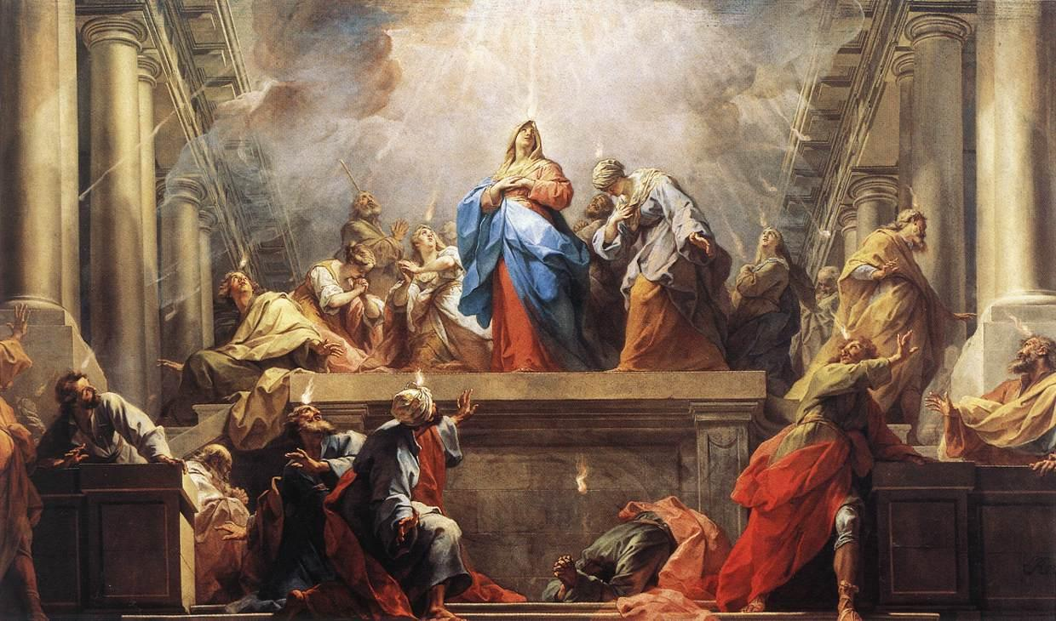
The Sweet Sound of Surrender
Pastor Mark Schwarzbauer PhD
Family Worship Center

Slide 2

Acts 19:1-7
And it happened, while Apollos was at Corinth, that Paul, having passed through the upper regions, came to Ephesus. And finding some disciples 2 he said to them, “Did you receive the Holy Spirit when you believed?”
So they said to him, “We have not so much as heard whether there is a Holy Spirit.”
3 And he said to them, “Into what then were you baptized?”
So they said, “Into John’s baptism.”

Slide 3
Acts 19:1-7
4 Then Paul said, “John indeed baptized with a baptism of repentance, saying to the people that they should believe on Him who would come after him, that is, on Christ Jesus.”
5 When they heard this, they were baptized in the name of the Lord Jesus. 6 And when Paul had laid hands on them, the Holy Spirit came upon them, and they spoke with tongues and prophesied. 7 Now the men were about twelve in all.

Slide 4
Part One:
The Baptist IN/WITH the Holy Spirit

Slide 5
Pentecost 101
Family Worship Center
Rev. Mark
Schwarzbauer, Ph.D.

Slide 6
Pentecost 102
Q&A
Family Worship Center
Rev. Mark
Schwarzbauer, Ph.D.

Slide 7
Acts 19:1-7
And it happened, while Apollos was at Corinth, that Paul, having passed through the upper regions, came to Ephesus. And finding some disciples 2 he said to them, “Did you receive the Holy Spirit when you believed?”
So they said to him, “We have not so much as heard whether there is a Holy Spirit.”
3 And he said to them, “Into what then were you baptized?”
So they said, “Into John’s baptism.”

Slide 8
Acts 19:1-7
And it happened, while Apollos was at Corinth, that Paul, having passed through the upper regions, came to Ephesus. And finding some disciples 2 he said to them, “Did you receive the Holy Spirit when you believed?”
So they said to him, “We have not so much as heard whether there is a Holy Spirit.”
3 And he said to them, “Into what then were you baptized?”
So they said, “Into John’s baptism.”

Slide 9
Did you receive the Holy Spirit
1. Paul is not referring to being sealed with the Spirit, as all believers have the Holy Spirit at the moment they are reborn.
2. Paul is referring to the subsequent experience of receiving the supernatural Baptism in the Holy Spirit with the evidence of Speaking with other tongues, just like at Pentecost.

Slide 10
Acts 19:1-7
4 Then Paul said, “John indeed baptized with a baptism of repentance, saying to the people that they should believe on Him who would come after him, that is, on Christ Jesus.”
5 When they heard this, they were baptized in the name of the Lord Jesus. 6 And when Paul had laid hands on them, the Holy Spirit came upon them, and they spoke with tongues and prophesied. 7 Now the men were about twelve in all.

Slide 11
Acts 19:1-7
4 Then Paul said, “John indeed baptized with a baptism of repentance, saying to the people that they should believe on Him who would come after him, that is, on Christ Jesus.”
5 When they heard this, they were baptized in the name of the Lord Jesus. 6 And when Paul had laid hands on them, the Holy Spirit came upon them, and they spoke with tongues and prophesied. 7 Now the men were about twelve in all.

Slide 12
Don’t let the enemy get you hung up and missing out.

Slide 13
Part Two:
Why it is Difficult for Some People to Surrender and Release

Slide 14
Barriers to Releasing to the Holy Spirit
Sometimes it is fear that causes us to hold back.
Sometimes it is concern over losing control.
Sometimes it is a misunderstanding of how the release comes.

Slide 15
The barrier of fear that I may be opening myself up to the devil!

Slide 16
…I had a pastor I respected instill that fear in me with negative and weird stories.

Slide 17
Cessationist preachers like John MacArthur instill fear attributing speaking in tongues to either psychological instability or demonic forgery.”

Slide 18
John Wesley, founder of the Methodist church, attributes such opposition to jealousy as he stated “men began even then to ridicule whatever gifts they had not themselves, and to decry them all as either madness or impostures.”

Slide 19
Then I read the Scriptures about Surrender to the Father…
Luke 11:9-13

Slide 20
Luke 11:9-13
⁹ “So I say to you, ask, and it will be given to you; seek, and you will find; knock, and it will be opened to you. ¹⁰ For everyone who asks receives, and he who seeks finds, and to him who knocks it will be opened. ¹¹ If a son asks for bread from any father among you, will he give him a stone? Or if he asks for a fish, will he give him a serpent instead of a fish? ¹² Or if he asks for an egg, will he offer him a scorpion? ¹³ If you then, being evil, know how to give good gifts to your children, how much more will your heavenly Father give the Holy Spirit to those who ask Him!”

Slide 21
Father will not only protect you, He assures you based on His goodness and calls you to come and ask for the Holy Spirit.

Slide 22
The barrier of concern over losing control.

Slide 23
Barrier Over Losing Control
Praying in tongues does not leave a person out of control.
I Cor. 14:32 tells us the “spirits of the prophets are subject to the prophets.”
I Cor. 14:15 tells us it is a matter of the “will” or choice. You control when and where you release the Spirit.

Slide 24
Barrier Over Losing Control
In America we are very self-conscious and highly resistant to letting go.
Those who come from a chaotic background tend to be controlling to keep peace.
The Spirit is not going to control you. He will not override your free will.

Slide 25
The barrier of misunderstanding

Slide 26
Sometimes we misunderstand and think that God will make us speak; you need to do the speaking. God will not manipulate you or control you.

Slide 27
Reflecting on why it took 3 years for the release of the Holy Spirit in his life, Jack Hayford in The Beauty of Spiritual Language says “I said nothing, because I supposed that speaking in tongues was, well, more a linguistic seizure of some kind, rather than a voluntary point of participation with the Holy Spirit giving utterance. “ page 43

Slide 28
Robert Morris corrects the “Myth – It’s just going to jump out of you one day.” No it doesn’t, example of walking past offering plate and a dollar jumps out of your wallet – wow I have the gift of giving! Doesn’t happen without you. You have to take action and participate.

Slide 29
You need to start with repentance and accepting Christ to have the Spirit of God inside of you.

Slide 30
Closing: If you have already received the Baptism in the Holy Spirit with the initial physical evidence of speaking in tongues then exercise your gift. If you have not received continue seeking God and surrender.

