Slide 1
Myths & Marvels Pastor Mark Schwarzbauer PhD Family Worship Center

Slide 2
Acts 2:1-4
When the Day of Pentecost had fully come, they were all with one accord in one place. ² And suddenly there came a sound from heaven, as of a rushing mighty wind, and it filled the whole house where they were sitting. ³ Then there appeared to them divided tongues, as of fire, and one sat upon each of them. ⁴ And they were all filled with the Holy Spirit and began to speak with other tongues, as the Spirit gave them utterance.

Slide 3
Hebrews 6:1-3
“Therefore, leaving the discussion of the elementary principles of Christ, let us go on to perfection, not laying again the foundation of repentance from dead works and of faith toward God, ² of the doctrine of baptisms, of laying on of hands, of resurrection of the dead, and of eternal judgment. ³ And this we will do if God permits.”

Slide 4
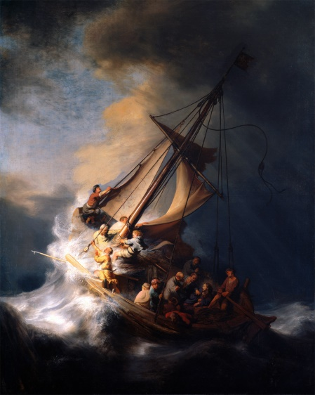
Pastor Mark Schwarzbauer PhD Family Worship Center
Foundation of Repentance
The Lost Art of
Repentance

Slide 5
Repent(ance) ~ Verb (action word) Metanoeo means to change one’s mind and purpose, as the result of acquired knowledge. Used with the cognate noun Metanoia to indicate true repentance. You change your lifestyle to reflect that you have changed your mind to thinking God’s way.

Slide 6
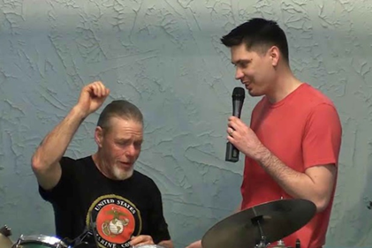
Why Does God Want You to Get Baptized? Pastor Mark Schwarzbauer PhD Family Worship Center

Slide 7
The purpose of water baptism is to symbolize the transformation you have experienced in Christ and to publicly proclaim your personal faith.

Slide 8
Hebrews 6:1-3
“Therefore, leaving the discussion of the elementary principles of Christ, let us go on to perfection, not laying again the foundation of repentance from dead works and of faith toward God, ² of the doctrine of baptisms, of laying on of hands, of resurrection of the dead, and of eternal judgment. ³ And this we will do if God permits.”
The doctrine of baptisms is PLURAL.
The first is baptism in water.
The second is the
baptism in the Holy Spirit.

Slide 9
Myths & Marvels Pastor Mark Schwarzbauer PhD Family Worship Center

Slide 10
Part One: A Bakers Dozen Myths about Pentecost and Pentecostals

Slide 11
Myth 1: Pentecostals believe weird stuff that isn’t in the Bible.
FALSE
FALSE
FALSE
FALSE

Slide 12
Fact- Pentecostals like the Assemblies of God believe the entire Bible and that the Bible alone is the only rule for faith and practice. We believe the Baptism in the Holy Spirit with the evidence of speaking in tongues, just like what happened on Pentecost and throughout the Book of Acts, is still for today (Acts 2:38).

Slide 13
Myth 2 – Pentecostals are isolated to a few small denominations.
FALSE
FALSE
FALSE
FALSE

Slide 14
Fact – There are Pentecostal Anglicans, Pentecostal Methodists, Pentecostal Lutherans, Pentecostal Baptists and huge numbers of Pentecostal Catholics. A 2011 Pew Research Center study revealed that Pentecostals and charismatics make up more than a quarter of all Christians today. And last year the leader of all Anglicans, the Archbishop of Canterbury, Justin Welby, admitted that he speaks in tongues. http://www.charismanews.com/opinion/44531-10-top-misconceptions-about-pentecostal-christians

Slide 15
Myth 3 – Islam is the fastest growing faith in the world. .
FALSE
FALSE
FALSE
FALSE

Slide 16
Fact – “Islam is not the fastest-growing faith family in the world. Pentecostalism is. While Islam has gone from zero in 610 AD to 1.6 billion today (1,403 years), Pentecostalism went from zero to (about) a billion from 1906 to the present day (107 years).” http://www.charismanews.com/opinion/44242-10-things-you-didn-t-know-about-pentecostals

Slide 17
Myth 4 - Pentecostals are usually uneducated.
FALSE
FALSE
FALSE
FALSE

Slide 18
Fact – Pentecostals have built more than just schools, hospitals and orphanages around the world for the poor; they have also built thousands of colleges and universities like Regent University, Oral Roberts University and Evangel University. “The largest seminary in the Church of England (and perhaps the entire Anglican communion) is St. Mellitus College/St. Paul's Theological Center in London, spiritually godfathered by (Charismatic) Holy Trinity Brompton Church.” http://www.charismanews.com/opinion/44242-10-things-you-didn-t-know-about-pentecostals

Slide 19
Myth 5 - Pentecostals are snake handlers.
FALSE
FALSE
FALSE
FALSE

Slide 20
Fact – There are only a few small churches that practice “snake handling” and the Pentecostal denominations like the A/G have all condemned the practice.

Slide 21
Myth 6 – People who speak in tongues are psychologically unstable.
FALSE
FALSE
FALSE
FALSE

Slide 22
Fact – The New York Times reported in 2006 that a study of Christians in England suggested that those who spoke in tongues "were more emotionally stable than those who did not." http://www.charismanews.com/opinion/44531-10-top-misconceptions-about-pentecostal-christians. Also, Luther P. Gerlach, PhD Professor emeritus of Anthropology, University of Minnesota in his longitudinal study of charismatics/Pentecostals concluded they tend to be “outstandingly stable individuals.”

Slide 23
Myth 7 – Pentecostals tend to be racially segregated.
FALSE
FALSE
FALSE
FALSE

Slide 24
Fact – “Pentecostal and charismatic churches are more likely to be racially mixed than other denominational groups. This is primarily because the essence of the Pentecostal experience, as described in the Book of Acts, involves the breaking down of racial and cultural walls by the power of the Holy Spirit.” http://www.charismanews.com/opinion/44531-10-top-misconceptions-about-pentecostal-christians.

Slide 25
Myth 8 – Pentecostalism is a passing fad.
FALSE
FALSE
FALSE
FALSE

Slide 26
Fact – “Pentecostals only represented 6 percent of all Christians in the year 1980. Today that number has jumped to 26 percent. And the Pulitzer Center reports that 35,000 people join Pentecostal churches every day. http://www.charismanews.com/opinion/44531-10-top-misconceptions-about-pentecostal-christians.

Slide 27
Myth 9 – Pentecostals believe you must speak in tongues in order to be saved.
FALSE
FALSE
FALSE
FALSE

Slide 28
Fact –While there is a very small group (UPC) that believes that error, the Assemblies of God (The largest Pentecostal denomination in the world) along with almost every other Pentecostal group does NOT believe you have to speak in tongues to be saved. Salvation comes by grace through faith alone. http://ag.org/top/Beliefs/topics/baptmhs_faq.cfm#heavenwithout

Slide 29
Myth 10 – Tongues are not for today
FALSE
FALSE
FALSE
FALSE

Slide 30
Fact –The only ones who believe that tongues are not for today are the Jehovah’s Witnesses and a small group of cessationists like John MacArthur. Although they occasionally grossly distort a verse from I Cor. 13 to support their error, there is not one scripture saying that tongues are not for today.

Slide 31
Myth 11 - The Baptism in the Holy Spirit happened at salvation.
FALSE
FALSE
FALSE
FALSE

Slide 32
Fact –The Holy Spirit seals us and baptizes us into the body of Christ at Salvation. That is the Baptism OF the Holy Spirit. However, the Baptism IN/WITH the Holy Spirit is scripturally a subsequent experience; the disciples were saved and received the Holy Spirit in John 20:22 (after the resurrection) and were subsequently Baptized IN the Holy Spirit in Acts 2.

Slide 33
Myth 12 - Speaking in tongues is the least of the gifts.
FALSE
FALSE
FALSE
FALSE

Slide 34
Fact –There is nowhere it says “tongues is the least of the gifts”; this is a misnomer from wrongly interpreting I Cor. 12:28. This false theory purports that since tongues is mentioned last, it is therefore the least of the gifts and furthermore unnecessary. By that errant logic, in I Cor. 13:13 love is mentioned last. Is love therefore the least? Love is in fact called the “greatest”…

Slide 35
If one follows their errant logic, the next mention of tongues places it first in I Cor. 13. So by that standard it is greatest gift. Self-control is the last fruit of the Spirit mentioned (Galatians 5:22-23). The flawed logic of those who promote tongues as the least, and therefore imply it is unnecessary, means self-control is the least and therefore unnecessary!

Slide 36
Myth 13 – According to I Corinthians 12:30 Paul teaches that tongues is not for everyone.
FALSE
FALSE
FALSE
FALSE

Slide 37
Fact –The error of this myth is due to the failure to delineate between the public use of the gift of tongues as a message vs. the prayer language of tongues. The passage of I Cor. 12:30 refers to the gift of tongues as a public message during church to be given by two or at most three, and in conjunction with interpretation (I Cor. 14:27&28).

Slide 38
The gift of tongues, which is a personal prayer language, is the initial physical evidence of the Baptism in the Holy Spirit. This gift of tongues is used in personal prayer and worship. Concerning tongues as a prayer language, Paul says in I Corinthians 14:5 “I wish you all spoke in tongues” and concludes in vs. 15 that we should not only all speak with tongues but also sing in them.

Slide 39
Part Two: The Baptist IN/WITH the Holy Spirit

Slide 40
Pentecost 101 Family Worship Center Rev. Mark Schwarzbauer, Ph.D.

Slide 41
Pentecost 102 Q&A Family Worship Center Rev. Mark Schwarzbauer, Ph.D.

Slide 42
The Baptism in the Holy Spirit is in all 4 Gospels and the Book of Acts.

Slide 43
Matthew 3:11
“I indeed baptize you with water unto repentance, but He who is coming after me is mightier than I, whose sandals I am not worthy to carry. He will baptize you with the Holy Spirit.”

Slide 44
Mark 1:8
“I indeed baptized you with water, but He will baptize you with the Holy Spirit.”

Slide 45
Luke 3:16
“John answered, saying to all, “I indeed baptize you with water; but One mightier than I is coming, whose sandal strap I am not worthy to loose. He will baptize you with the Holy Spirit and fire.”

Slide 46
John 1: 32-33
And John bore witness, saying, “I saw the Spirit descending from heaven like a dove, and He remained upon Him. 33 I did not know Him, but He who sent me to baptize with water said to me, ‘Upon whom you see the Spirit descending, and remaining on Him, this is He who baptizes with the Holy Spirit.’

Slide 47
Acts 1:5
(Jesus said) “for John truly baptized with water, but you shall be baptized with the Holy Spirit not many days from now.”

Slide 48
Fr. Dennis Bennett in his book “How to Pray for the Release of the Holy Spirit” explains how the Baptism in the Holy Spirit is a release of the Holy Spirit who already lives inside of you as a believer.

Slide 49
You already have the Holy Spirit in you when you are born again. Therefore, the Baptism in/with the Holy Spirit is not trying to get the Holy Spirit to come to you. The Baptism in the Holy Spirit is releasing the Holy Spirit who is in you to flow through and from you.

Slide 50
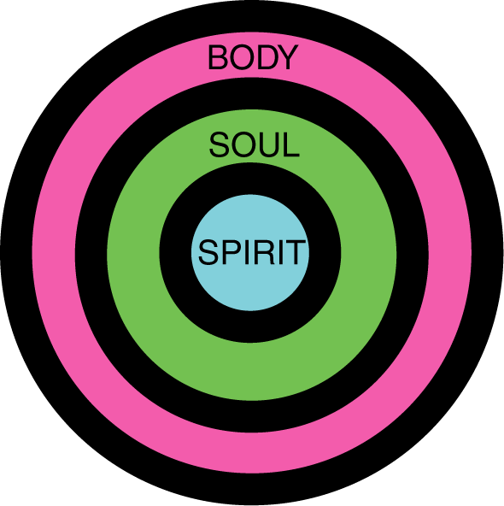
Your 3-Fold Nature
The Baptism in the Holy Spirit is letting the person of the Holy Spirit flow from your spirit through you.

Slide 51
Your 3-Fold Nature
When you let the Holy Spirit into your soul (the psychological part of you) He baptizes your intellect (thoughts), your emotions (feelings), and your will (motivations and desires).

Slide 52
Your 3-Fold Nature
When you let the Holy Spirit into your body (the physical part of you) He gives you strength and health and flows in the prayer language of tongues praying the perfect will of God and building you up.

Slide 53
On this Pentecost Sunday, join our almost one billion brothers and sisters around the world in allowing the Holy Spirit to baptize you and flow through your life.

