Slide 1
Pentecost 102
Q&A
Family Worship Center
Rev. Mark
Schwarzbauer, Ph.D.

Slide 2

Acts 2:1-4
¹When the Day of Pentecost had fully come, they were all with one accord in one place. ²And suddenly there came a sound from heaven, as of a rushing mighty wind, and it filled the whole house where they were sitting.

Slide 3
Acts 2:1-4
³Then there appeared to them divided tongues, as of fire, and one sat upon each of them. ⁴And they were all filled with the Holy Spirit and began to speak with other tongues, as the Spirit gave them utterance.

Slide 4
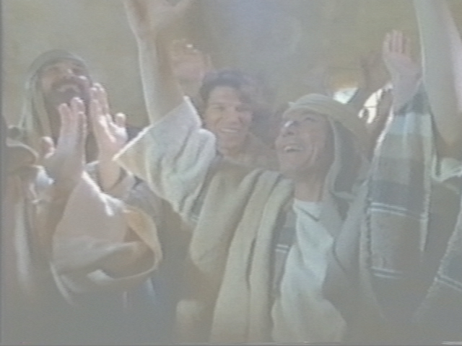
Review of Pentecost 101

Slide 5
Introduction: Pentecost
Pentecostals- distinctive of Baptism in Holy Spirit.
Traced Throughout the centuries.
  Revivals of 1700-1800s.
  Azusa st. 1906.
  1914 A/G formed.

Slide 6
Introduction: Pentecost
  1959- Charismatic movement starts when Episcopal priest Dennis Bennett announces that he speaks with tongues.
  1967- Roman Catholic Charismatic movement begins in Pittsburgh.

Slide 7
Introduction: Pentecost
Pentecostals in all denominations.
Largest protestant group in the world.
A/G Largest protestant church in countries like Brazil ~(which has the 2nd largest Christian pop in the world) ~3x more AG than Baptists, 8x more AG than Lutherans.

Slide 8
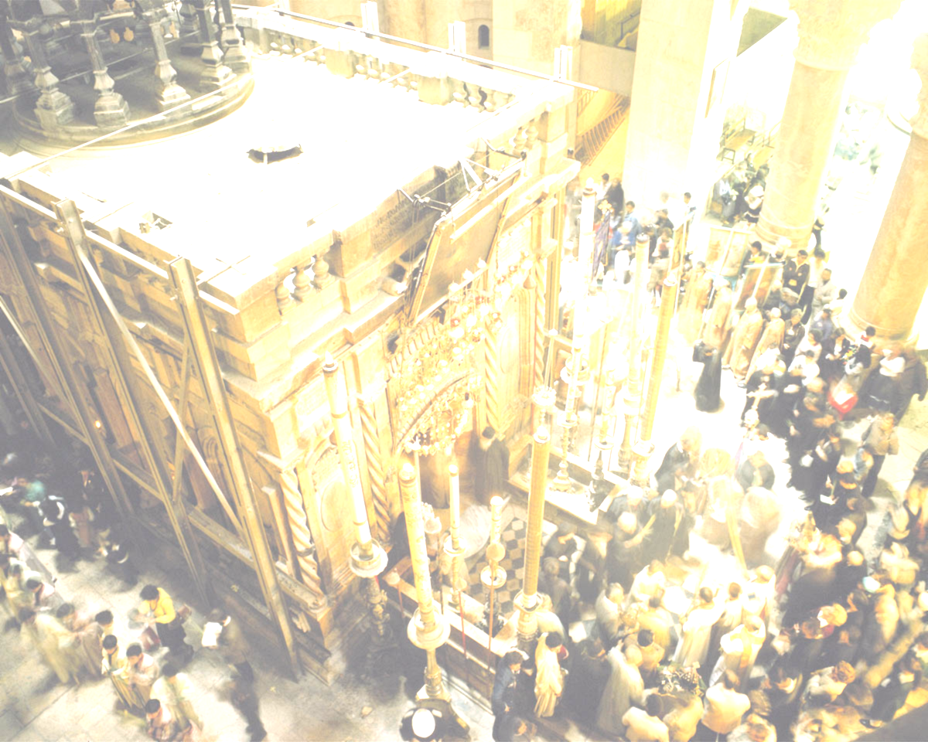
New Testament Pentecost
Acts 2:1-42
The fulfillment of Joel 2:8-32
Giving of the Ruach HaKodesh (Holy Spirit)
The Baptism of the Holy Spirit
The first fruits harvest of souls

Slide 9
Pentecostal Doctrine has the same cardinal doctrines as orthodox Christianity
God- the Trinity
The deity of Christ
Atoning work of Christ on cross
The bodily resurrection
The fallen nature of man
Salvation by grace through faith

Slide 10
Assemblies of God distinctives, which we consider essential to the church's core mission of reaching the world for Christ.
Salvation
Baptism in the Holy Spirit
Divine healing
The second coming of Christ

Slide 11
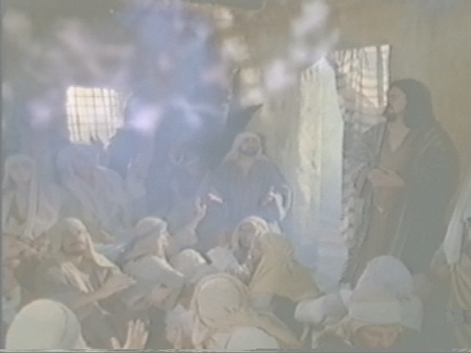
The Baptism in the Holy Spirit –
Our Power

Slide 12
The normal experience of everyone in the early church

Slide 13
This experience is distinct from and subsequent to the experience of the new birth

Slide 14
You already have the Holy Spirit within you at new birth
The Baptism in the Holy Spirit is an immersion in power

Slide 15
The initial physical evidence of speaking with other tongues

Slide 16
The Experience of Pentecost
Acts 2:1-4
Acts 8:9-25
Acts 9:17 & I Cor 14:18
Acts 10:44-48
Acts 19:1-6

Slide 17
Question One:
Do all speak with tongues?

Slide 18
“ I speak in tongues and believe in this gift. 1Cor 12 seems to explain the giving of this gift pretty plainly. Verse 11 states that the Holy Spirit distributes to each one individually as HE wills. He goes on to describe the differing parts of the physical body as a way to help us understand how these differing gifts are to work together in harmony. In 12:27-30 he affirms our individuality and asks "...Do all have gifts of healings? Do all speak with tongues? Do all interpret? Seems to beg the answer NO, the Spirit does the distributing at His will.

Slide 19
Years ago i heard a sermon stating that this was meant to promote order during church services but I can not find this in context. If we are to believe that speaking in tongues is somehow "required" as proof of being filled with the Holy Spirit or the Holy Spirit being "released" in us, this seems to be saying that unless you speak in tongues you are not filled, or being filled by the Holy Spirit or that the Holy Spirit's power cannot be released in a person. Please comment next Sunday and or via email to help clarify my thoughts on this. I do not want to be or stay in error in my thinking. I would think that possibly others also have similar thoughts or questions.”

Slide 20
The “gift of tongues” is the same in essence in Acts & Corinthians but differs in use and purpose.

Slide 21
The 1st use of the gift of tongues is as initial physical evidence of the Baptism of the Holy Spirit (or “release” as Dennis Bennett prefers to use).

Slide 22
The 2nd use of the gift of tongues is as a ministry gift used in the church service to give a message.

Slide 23
The context of I Cor. 12:11 starts in I Cor. 11:18… “when you come together as a church”, and is reinforced as the church meeting in language of I Cor. 12:12… “the body.”

Slide 24
Tongues as ministry gift in the church service…
Gives a message from God (I Cor. 12-14).
A public message must be accompanied by an interpretation for everyone to be edified.
Limited to 2 or 3 to present out of balance with other gifts due to zealousness.

Slide 25
The 3rd use of the gift of tongues as used as a personal prayer language.
(I Cor. 14:14-15, Romans 8:26)

Slide 26
The 4th use of the gift of tongues is to worship or “sing in the spirit.”
(I Cor. 14:14-15)

Slide 27
Don’t misapply the context of the gifts in a church service to the experience of the Baptism of the Holy Spirit.

Slide 28
Rules of Interpretation
Context, Context, Context.
Literary context
The sitz em leben (the situation in life).
The sitz em glauben (the situation of faith)

Slide 29
Answer: Not all speak with tongues in the church service but all do as initial physical evidence of the Baptism of the Holy Spirit

Slide 30
Question 2:
But my experience is I received the Baptism without Tongues…

Slide 31
Question… My experience, and some others I know, think we received the Baptism of the Holy Spirit but we didn’t speak in tongues. Isn’t my experience as valid as another persons?

Slide 32
At first this seems like a totally valid argument….
But stop and analyze it

Slide 33
That is making our experience the authority instead of God’s Word.

Slide 34
That is interpreting the Bible by your experience instead of interpreting your experience by the Bible ~ you make yourself the authority instead of God’s Word.

Slide 35
The Bible is our sole rule of Faith and Practice.

Slide 36
As Martin Luther said…
Solo Scriptura.

Slide 37
II Timothy 3:16-17
¹⁶﻿All Scripture is given by inspiration of God, and is profitable for doctrine, for reproof, for correction, for instruction in righteousness, ¹⁷﻿that the man of God may be complete, thoroughly equipped for every good work.

Slide 38
God’s Word teaches that speaking in tongues is the initial physical evidence.

Slide 39
Initial (always the first but not the only)
Physical (there are also spiritual ones to follow).

Slide 40
Dennis Bennett warned about the people making this mistake when the charismatic movement started.

Slide 41
Answer: Your experience with the Holy Spirit was no doubt special, edifying, an anointing or “filling” but it was not the Baptism in the Holy Spirit according the Bible.

Slide 42
Question 3:
Why is tongues the initial physical evidence, isn’t that the least of the gifts?

Slide 43
Question: Why would God use the gift of tongues as the initial physical evidence when the Bible says tongues is the least of the gifts?

Slide 44
There is nowhere it says “tongues is the least of the gifts”; this is a misnomer from wrongly interpreting
I Cor. 12:28 ~

Slide 45
Theory… Tongues is mentioned last to it is the least of the gifts and by implication unnecessary

Slide 46
Consider I Cor. 13:13 where love is mentioned last, is love therefore the least?

Slide 47
Tongues in mentioned first in I Cor. 13 so by that standard tongues is the greatest gift.

Slide 48
Self control is the last fruit of the Spirit mentioned (Galatians 5:22-23)… the flawed logic of those who promote tongues as the least and therefore imply it is unnecessary means self control is the least and therefore unnecessary!

Slide 49
The value of tongues is in edification.
In the church service use it requires interpretation to edify (I Cor. 14).
When accompanied by interpretation it is equal to prophecy (I Cor. 14:5).

Slide 50
One reason
God chose tongues is
James 3:2-10.

Slide 51
James 3:2-10
The tongue is like a rudder and turns you.
The tongue is like a fire destroying you and others.
The tongue is an unruly evil full of poison.
No man can tame the tongue- you need God’s help here.
In the Baptism in the Holy Spirit you yield your tongue to God.

Slide 52
God uses tongues to edify and build you up

Slide 53
I Cor. 14:4 when you speak in a tongue you edify yourself ~ build yourself up.

Slide 54
Pray God’s perfect will ~ Romans 8:26
²⁶﻿Likewise the Spirit also helps in our weaknesses. For we do not know what we should pray for as we ought, but the Spirit Himself makes intercession for us with groanings which cannot be uttered.

Slide 55
This is why Paul says “I thank my God I speak in tongues more than all of you!”
(I Cor. 14:18).

Slide 56
Closing-
Be open to the person and work of the Holy Spirit.

