Slide 1
Pentecost 101 Family Worship Center Rev. Mark Schwarzbauer, Ph.D.

Slide 2
Acts 2:1-4
¹When the Day of Pentecost had fully come, they were all with one accord in one place. ²And suddenly there came a sound from heaven, as of a rushing mighty wind, and it filled the whole house where they were sitting.

Slide 3
Acts 2:1-4
³Then there appeared to them divided tongues, as of fire, and one sat upon each of them. ⁴And they were all filled with the Holy Spirit and began to speak with other tongues, as the Spirit gave them utterance.

Slide 4
Introduction: Pentecost

Slide 5
Introduction: Pentecost
Pentecostals- distinctive of Baptism in Holy Spirit. Distinctive – not emphasis.
2. Throughout the centuries the Baptism of the Holy Spirit was recorded as occurring in monasteries (where there was writing and therefore documentation) even in dark ages.

Slide 6
Introduction: Pentecost
John Wesley-founder Methodist church … “It does not appear that these extraordinary gifts of the Holy Ghost were common in the church for more than two or three centuries. We seldom hear of them after that fatal period when the Emperor Constantine called himself a Christian, and from a vain imagination of promoting the Christian cause,

Slide 7
Introduction: Pentecost
thereby heaped riches and power and honour upon the Christians in general, but in particular upon Christian clergy. From this time, they almost totally ceased; very few instances of the kind being found. The cause of this was not, as has been vulgarly supposed, because there is no more occasion for them because all the world were become Christian.

Slide 8
Introduction: Pentecost
This is a miserable mistake, not a twentieth part of it was then nominally Christian. The real cause was: the love of many, almost all Christians, so called, was waxed cold. The Christians had no more of the Spirit of Christ than the other heathen; the Son of Man when He came to examine His Church could hardly find faith..”

Slide 9
Introduction: Pentecost
This was the real cause why the extraordinary gifts of the Holy Ghost were no longer to be found in the Christian Church; because the Christians were turned heathen again, and had only a dead form left ...

Slide 10
Introduction: Pentecost
The grand reason why the miraculous gifts were so soon withdrawn was not that faith and holiness were well-nigh lost, but that dry, formal, orthodox men began even then to ridicule whatever gifts they had not themselves, and to decry them all as either madness or impostures.”

Slide 11
Introduction: Pentecost
Luther (1483-1546) was Baptized in the Holy Spirit and spoke with tongues.
The Quakers (1650)
D.L. Moody (1882) preached it regularly.
Revivals of 1700-1800s.

Slide 12
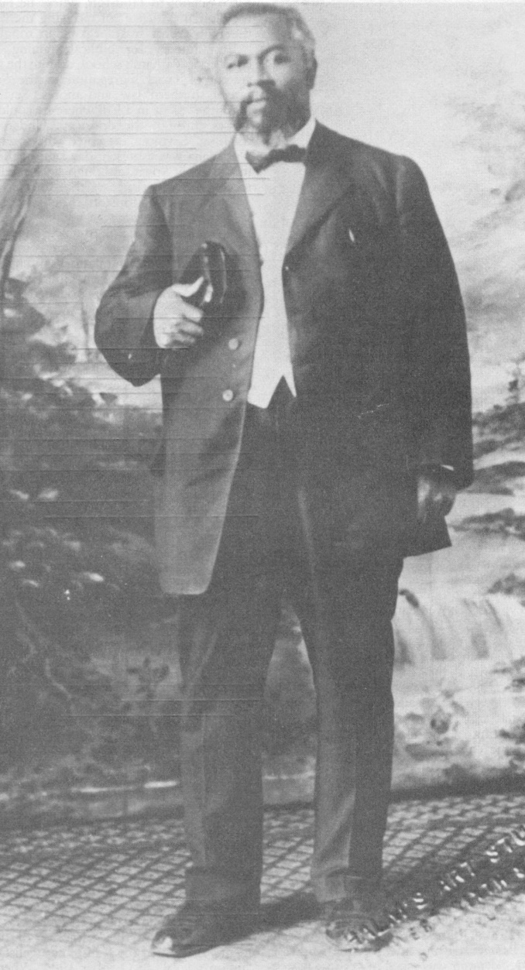
Introduction: Pentecost
Azusa st. 1906.
1914 A/G formed.

Slide 13
Introduction: Pentecost
1959- Charismatic movement starts when Episcopal priest Dennis Bennett announces that he speaks with tongues.
1967- Roman Catholic Charismatic movement begins in Pittsburgh.

Slide 14
Introduction: Pentecost
Pentecostals in all denominations and many waves.
Largest protestant group in the world.
There were 631 million Pentecostals in 2014 comprising nearly 1/4 of all Christians.

Slide 15
Introduction: Pentecost
There were only 63 million Pentecostals in 1970, and the number is expected to reach 800 million by 2025. Some estimates say by 2040 well over a billion will be Pentecostals.

Slide 16
Introduction: Pentecost
A/G Largest protestant church in other countries like Brazil and growing fast.
A/G now 100 years old.
Latino adherents make up 20 percent of the Fellowship.

Slide 17
Introduction: Pentecost
More than 40 percent of total adherents are ethnic minorities and Millennials (ages 18-34), who contributed 21 percent of the growth from 2001-2013.

Slide 18
Introduction: Pentecost
“The rapid growth of the church in the global world, along with the corresponding decline of the church in the global north, suggests that Pentecostalism will account for an ever larger percentage of Christianity in the future.” CT

Slide 19
The Jewish Feast of Pentecost
Also called the Feast of Weeks (Hebrew Shavuot)
In Exodus 23:16 it was referred to as the “Feast of Harvest.”

Slide 20
The Harvest Celebration
Yom Habikkurim, or “the Day of the First Fruits.”

Slide 21
New Testament Pentecost
Acts 2:1-42
The fulfillment of Joel 2:8-32
Giving of the Ruach HaKodesh (Holy Spirit)
The Baptism of the Holy Spirit
The first fruits harvest of souls

Slide 22
Pentecostal Doctrine has the same cardinal doctrines as orthodox Christianity
God- the Trinity
The deity of Christ
Atoning work of Christ on cross
The bodily resurrection
The fallen nature of man
Salvation by grace through faith

Slide 23
Assemblies of God distinctives, which we consider essential to the church's core mission of reaching the world for Christ.
Salvation
Baptism in the Holy Spirit
Divine healing
The second coming of Christ

Slide 24
Part One: Salvation- Our Purpose

Slide 25
Man is truly lost without God

Slide 26
Salvation
Romans 3:23 ²³for all have sinned and fall short of the glory of God,
Romans 6:23 ²³For the wages of sin is death, but the gift of God is eternal life in Christ Jesus our Lord.

Slide 27
Part Two: The Baptism in the Holy Spirit – Our Power

Slide 28
The normal experience of everyone in the early church

Slide 29
This experience is distinct from and subsequent to the experience of the new birth

Slide 30
You already have the Holy Spirit within you at new birth
The Baptism in the Holy Spirit is an immersion in power

Slide 31
The initial physical evidence of speaking with other tongues

Slide 32
The Experience of Pentecost
Acts 2:1-4
Acts 8:9-25
Acts 9:17 & I Cor 14:18
Acts 10:44-48
Acts 19:1-6

Slide 33
Part Three: Divine Healing- Our Privilege

Slide 34
Not Faith Healing but Divine Healing

Slide 35
Deliverance from sickness is provided for in the atonement, and is the privilege of all believers

Slide 36
Isaiah 53:4
⁴ Surely He has borne our griefs
And carried our sorrows;
Yet we esteemed Him stricken,
Smitten by God, and afflicted.

Slide 37
Isaiah 53:5
⁵ But He was wounded for our transgressions, He was bruised for our iniquities; The chastisement for our peace was upon Him, And by His stripes we are healed.

Slide 38
Matthew 8:16-17
¹⁶When evening had come, they brought to Him many who were demon-possessed. And He cast out the spirits with a word, and healed all who were sick, ¹⁷that it might be fulfilled which was spoken by Isaiah the prophet, saying:
“He Himself took our infirmities And bore our sicknesses.”

Slide 39
Part Four: The Second Coming of Christ- Our Prospect

Slide 40
The second coming of Christ includes the rapture of the saints, which is our blessed hope, followed by the visible return of Christ with His saints to reign on earth for one thousand years

Slide 41
Motivation to win the lost

Slide 42
Closing- Be open to the person and work of the Holy Spirit.

