Slide 1
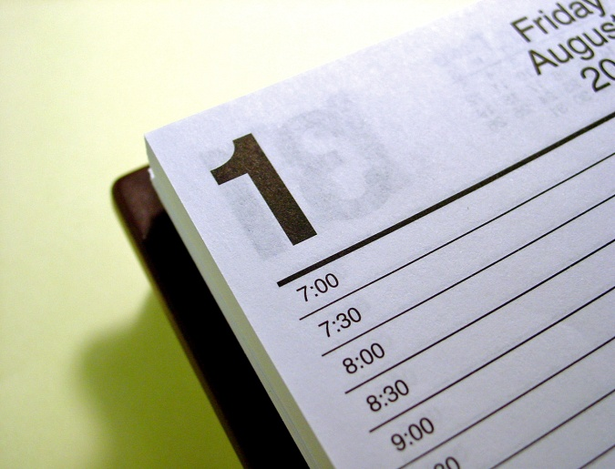
What’s Next on
God's
Calendar?
Family Worship Center
Pastor Mark Schwarzbauer, Ph.D.

Slide 2
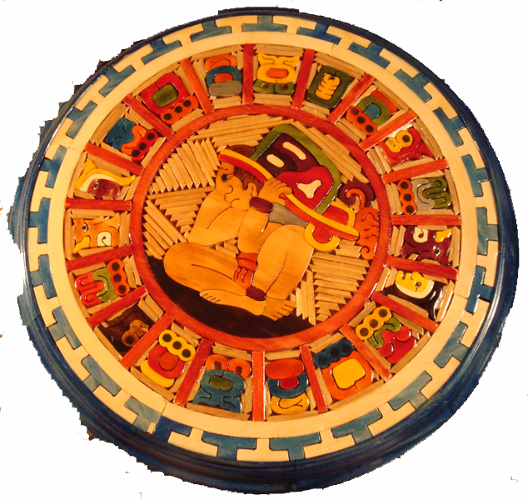
Will the World End In 2012?
Family Worship Center
Pastor Mark
Schwarzbauer, Ph.D.

Slide 3
I Thessalonians 4:13-18
¹³But I do not want you to be ignorant, brethren, concerning those who have fallen asleep, lest you sorrow as others who have no hope.

Slide 4
I Thessalonians 4:13-18
¹⁴For if we believe that Jesus died and rose again, even so God will bring with Him those who sleep in Jesus.

Slide 5
I Thessalonians 4:13-18
¹⁵For this we say to you by the word of the Lord, that we who are alive and remain until the coming of the Lord will by no means precede those who are asleep.

Slide 6
I Thessalonians 4:13-18
¹⁶For the Lord Himself will descend from heaven with a shout, with the voice of an archangel, and with the trumpet of God. And the dead in Christ will rise first.

Slide 7
I Thessalonians 4:13-18
¹⁷Then we who are alive and remain shall be caught up together with them in the clouds to meet the Lord in the air. And thus we shall always be with the Lord.

Slide 8
I Thessalonians 4:13-18
¹⁸Therefore comfort one another with these words.

Slide 9
Part One: On an Ordinary Day

Slide 10
video

Slide 11
The Rapture- When Jesus comes back to take the Christians away.

Slide 12
The Rapture- I Thessalonians 4:17
¹⁷ deinde nos qui vivimus qui relinquimur simul rapiemur cum illis in nubibus obviam Domino in aera et sic semper cum Domino erimus

Slide 13
The Rapture-
He brings with Him those who sleep
The Lord Himself descends
The voice of the Archangel and the trumpet of God
The dead rise and are reunited soul and body
We are "caught up" together with them to meet the Lord in the air

Slide 14
The Timing-
No man knows the day or hour, Matthew 25:13
Like a thief in the night, I Thessalonians 5:2-4
Signs of Israel, Matthew 24:32-34.
One is taken the other left, Matthew 24:40-42.

Slide 15
Part Two: Comfort

Slide 16
I Thessalonians 4:18
¹⁸Therefore comfort one another with these words.

Slide 17
I Thessalonians 5:11
¹¹Therefore comfort each other and edify one another, just as you also are doing.

Slide 18
Comfort, vs. 5:11, 4:18
παρακαλειτε (parakaleite)
Greek present active, IMPERATIVE
The "call along side", to encourage or console

Slide 19
Edification, vs. 5:11
οικοδομειτε (oikodomeite)
Greek present active, IMPERATIVE
Literally means "to build a house.“
Implies building up a person

Slide 20
Exhortation Hebrews 10:24-25
²⁴And let us consider one another in order to stir up love and good works, ²⁵not forsaking the assembling of ourselves together, as is the manner of some, but exhorting one another, and so much the more as you see the Day approaching.

Slide 21
Exhortation Hebrews 10:24-25
Consider one another…
Stir up love
Stir up good works
Exhorting to faithfulness to church

Slide 22
Part Three: The Readiness

Slide 23
Socrates proclaimed the basic philosophical premise, that “the unexamined life was not worth living.”

Slide 24
I John 3:1-3
¹Behold what manner of love the Father has bestowed on us, that we should be called children of God! Therefore the world does not know us, because it did not know Him.

Slide 25
I John 3:1-3
²Beloved, now we are children of God; and it has not yet been revealed what we shall be, but we know that when He is revealed, we shall be like Him, for we shall see Him as He is.

Slide 26
I John 3:1-3
³And everyone who has this hope in Him purifies himself, just as He is pure.

Slide 27
Comfort Encourage Prepare

