Slide 1
Nailing Your Stuff to the Cross Pastor Mark Schwarzbauer, Ph.D. Family Worship Center

Slide 2
Colossians 2:13-14
¹³ And you, being dead in your trespasses and the uncircumcision of your flesh, He has made alive together with Him, having forgiven you all trespasses, ¹⁴ having wiped out the handwriting of requirements that was against us, which was contrary to us. And He has taken it out of the way, having nailed it to the cross.

Slide 3
Part One: The Wounds From The Cross

Slide 4
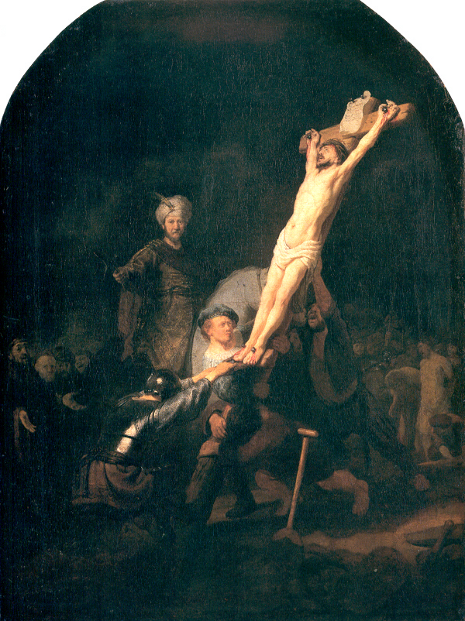

Slide 5
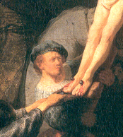

Slide 6
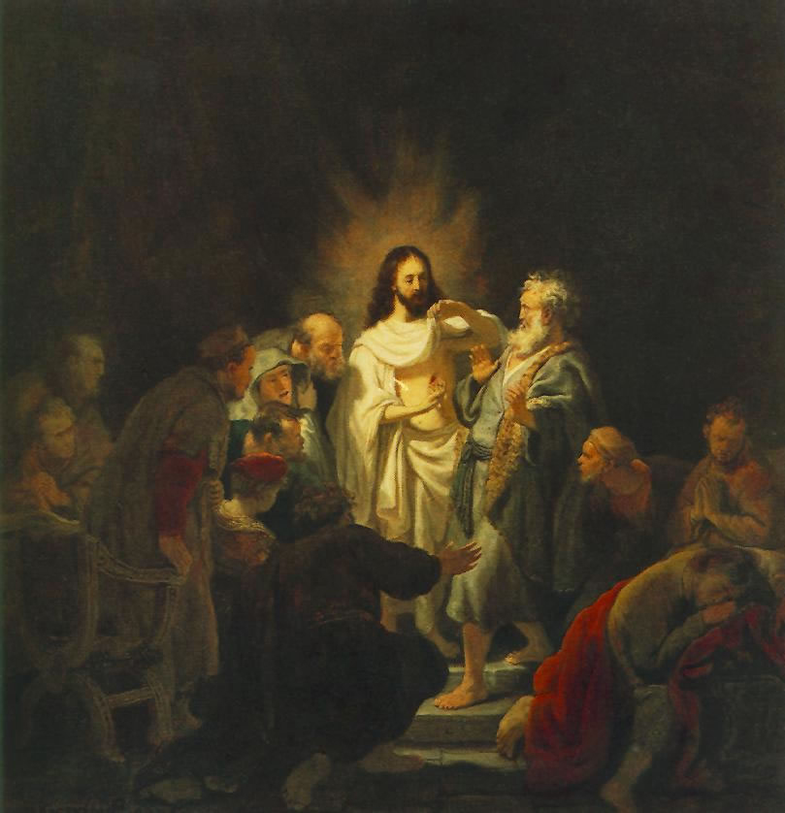
Rembrandt incredulity of St Thomas 50cm

Slide 7
Oscar Wilde The Picture of Dorian Gray

Slide 8
The picture that absorbed his sin and defilement.

Slide 9
Isaiah 53:3-6
³ He is despised and rejected by men, A Man of sorrows and acquainted with grief. And we hid, as it were, our faces from Him; He was despised, and we did not esteem Him.

Slide 10
⁴ Surely He has borne our griefs And carried our sorrows; Yet we esteemed Him stricken, Smitten by God, and afflicted.

Slide 11
But He was wounded for our transgressions, He was bruised for our iniquities; The chastisement for our peace was upon Him, And by His stripes we are healed.

Slide 12
⁶ All we like sheep have gone astray; We have turned, every one, to his own way; And the Lord has laid on Him the iniquity of us all.

Slide 13
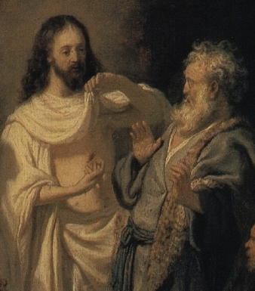
Isaiah 53:3-6
Despised and rejected.
He bore our griefs and carried our sorrows.
He was wounded for our transgressions.
Bruised for our iniquities.
The Chastisement for our peace was upon Him.

Slide 14
By His Stripes we are healed!

Slide 15
Part Two: The Effects of the Cross

Slide 16
The Effects of the Cross
The forgiveness of sins, I John 1:9.
Physical healing, Matthew 8:16-17.
Emotional healing, Matthew 8:28f.
Healing the total man at the cross.

Slide 17
Part Three: Nailing Your Stuff to the Cross

Slide 18
Colossians 2:13-14
¹³ And you, being dead in your trespasses and the uncircumcision of your flesh, He has made alive together with Him, having forgiven you all trespasses, ¹⁴ having wiped out the handwriting of requirements that was against us, which was contrary to us. And He has taken it out of the way, having nailed it to the cross.

Slide 19
Time for YOU to NAIL YOUR STUFF TO THE CROSS.

Slide 20
Galatians 2:20
²⁰“I have been crucified with Christ; it is no longer I who live, but Christ lives in me; and the life which I now live in the flesh I live by faith in the Son of God, who loved me and gave Himself for me.

